Slide 1
Archived and Streaming Data Analysis
TEAM- Bigdata Ninjas(BDN-11)

Slide 2

Loading of Streaming Data into Big Query Table
Creation of Bucket for storing live streaming flight data
Creation of Cloud function to extract data from Open-Sky API and to store data in the Bucket
Creation of Pub/Sub Topic
Creation of Steaming Dataflow Job to move the data from Bucket to Pub/Sub
Creation of Table in Big Query
Creation of Streaming Dataflow job to move the data from Pub/Sub to Big Query

Slide 3
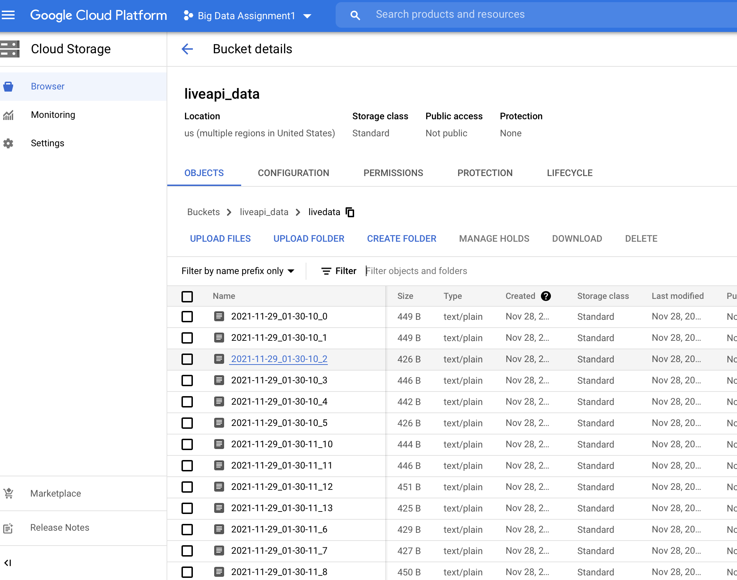
Bucket liveapi_data was created and a folder livedata was created under it

Slide 4
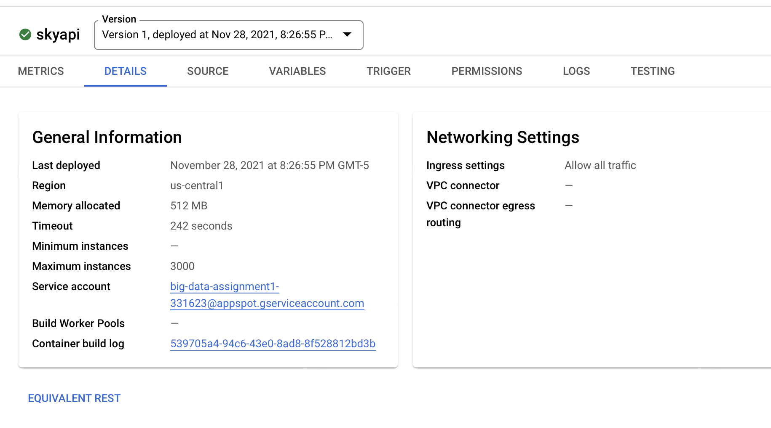
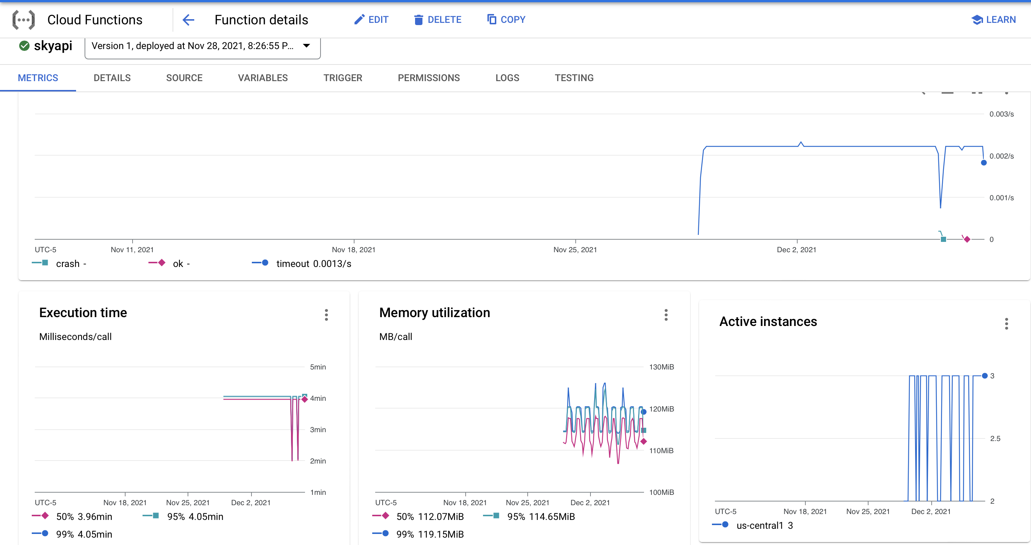
Cloud Function skyapi was created and deployed- To retrieve information from Open-Sky

Slide 5
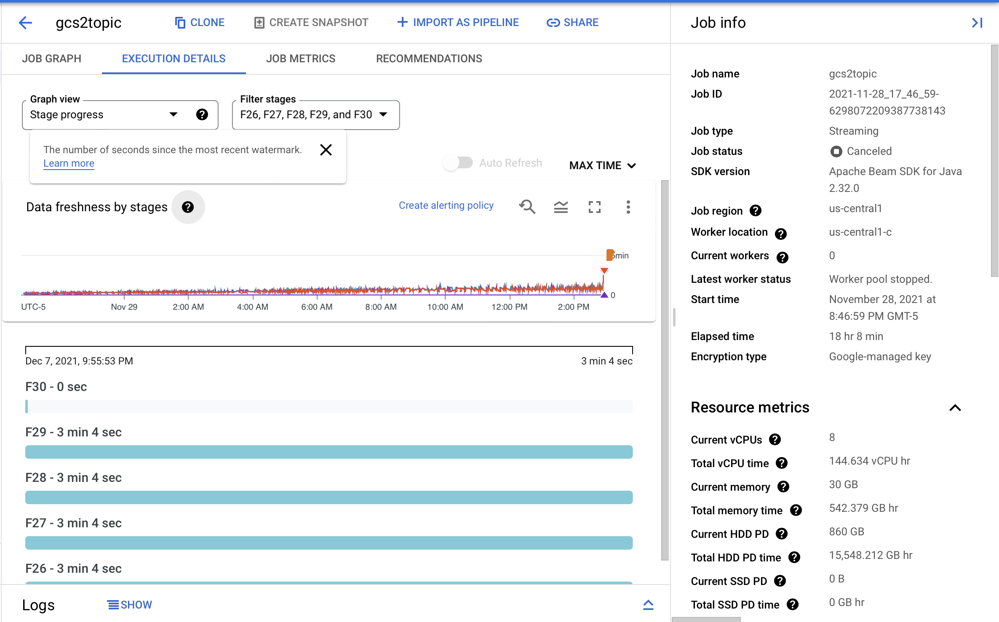
Streaming Dataflow Job gcs2topic was scheduled to move the data from storage to Pub/Sub Topic
Note-We cancelled the Job after running it for 18 hours

Slide 6
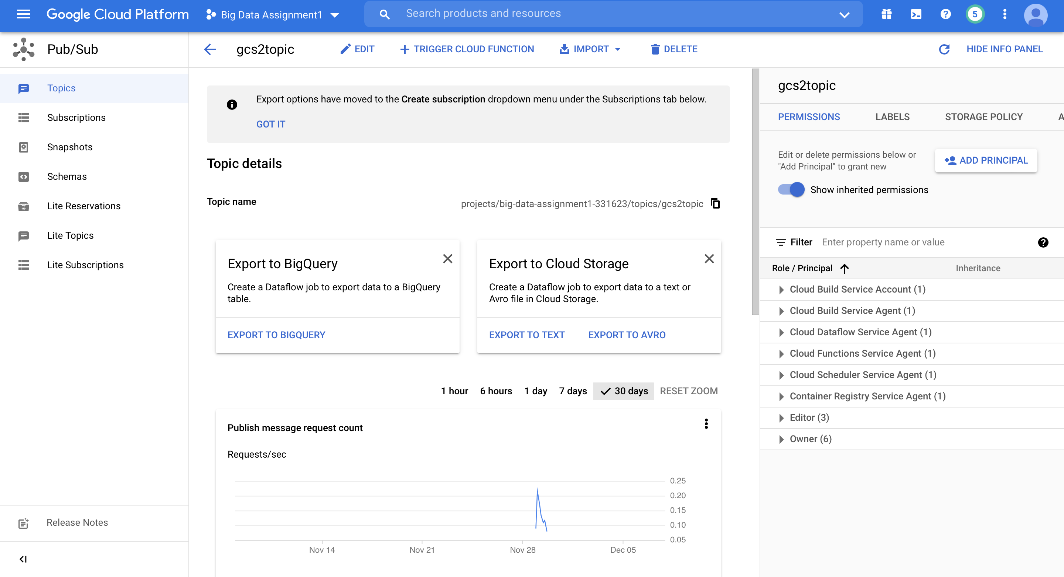
A Pub/Sub Topic gcs2topic was created to move the data from Pub/Sub to Big Query

Slide 7
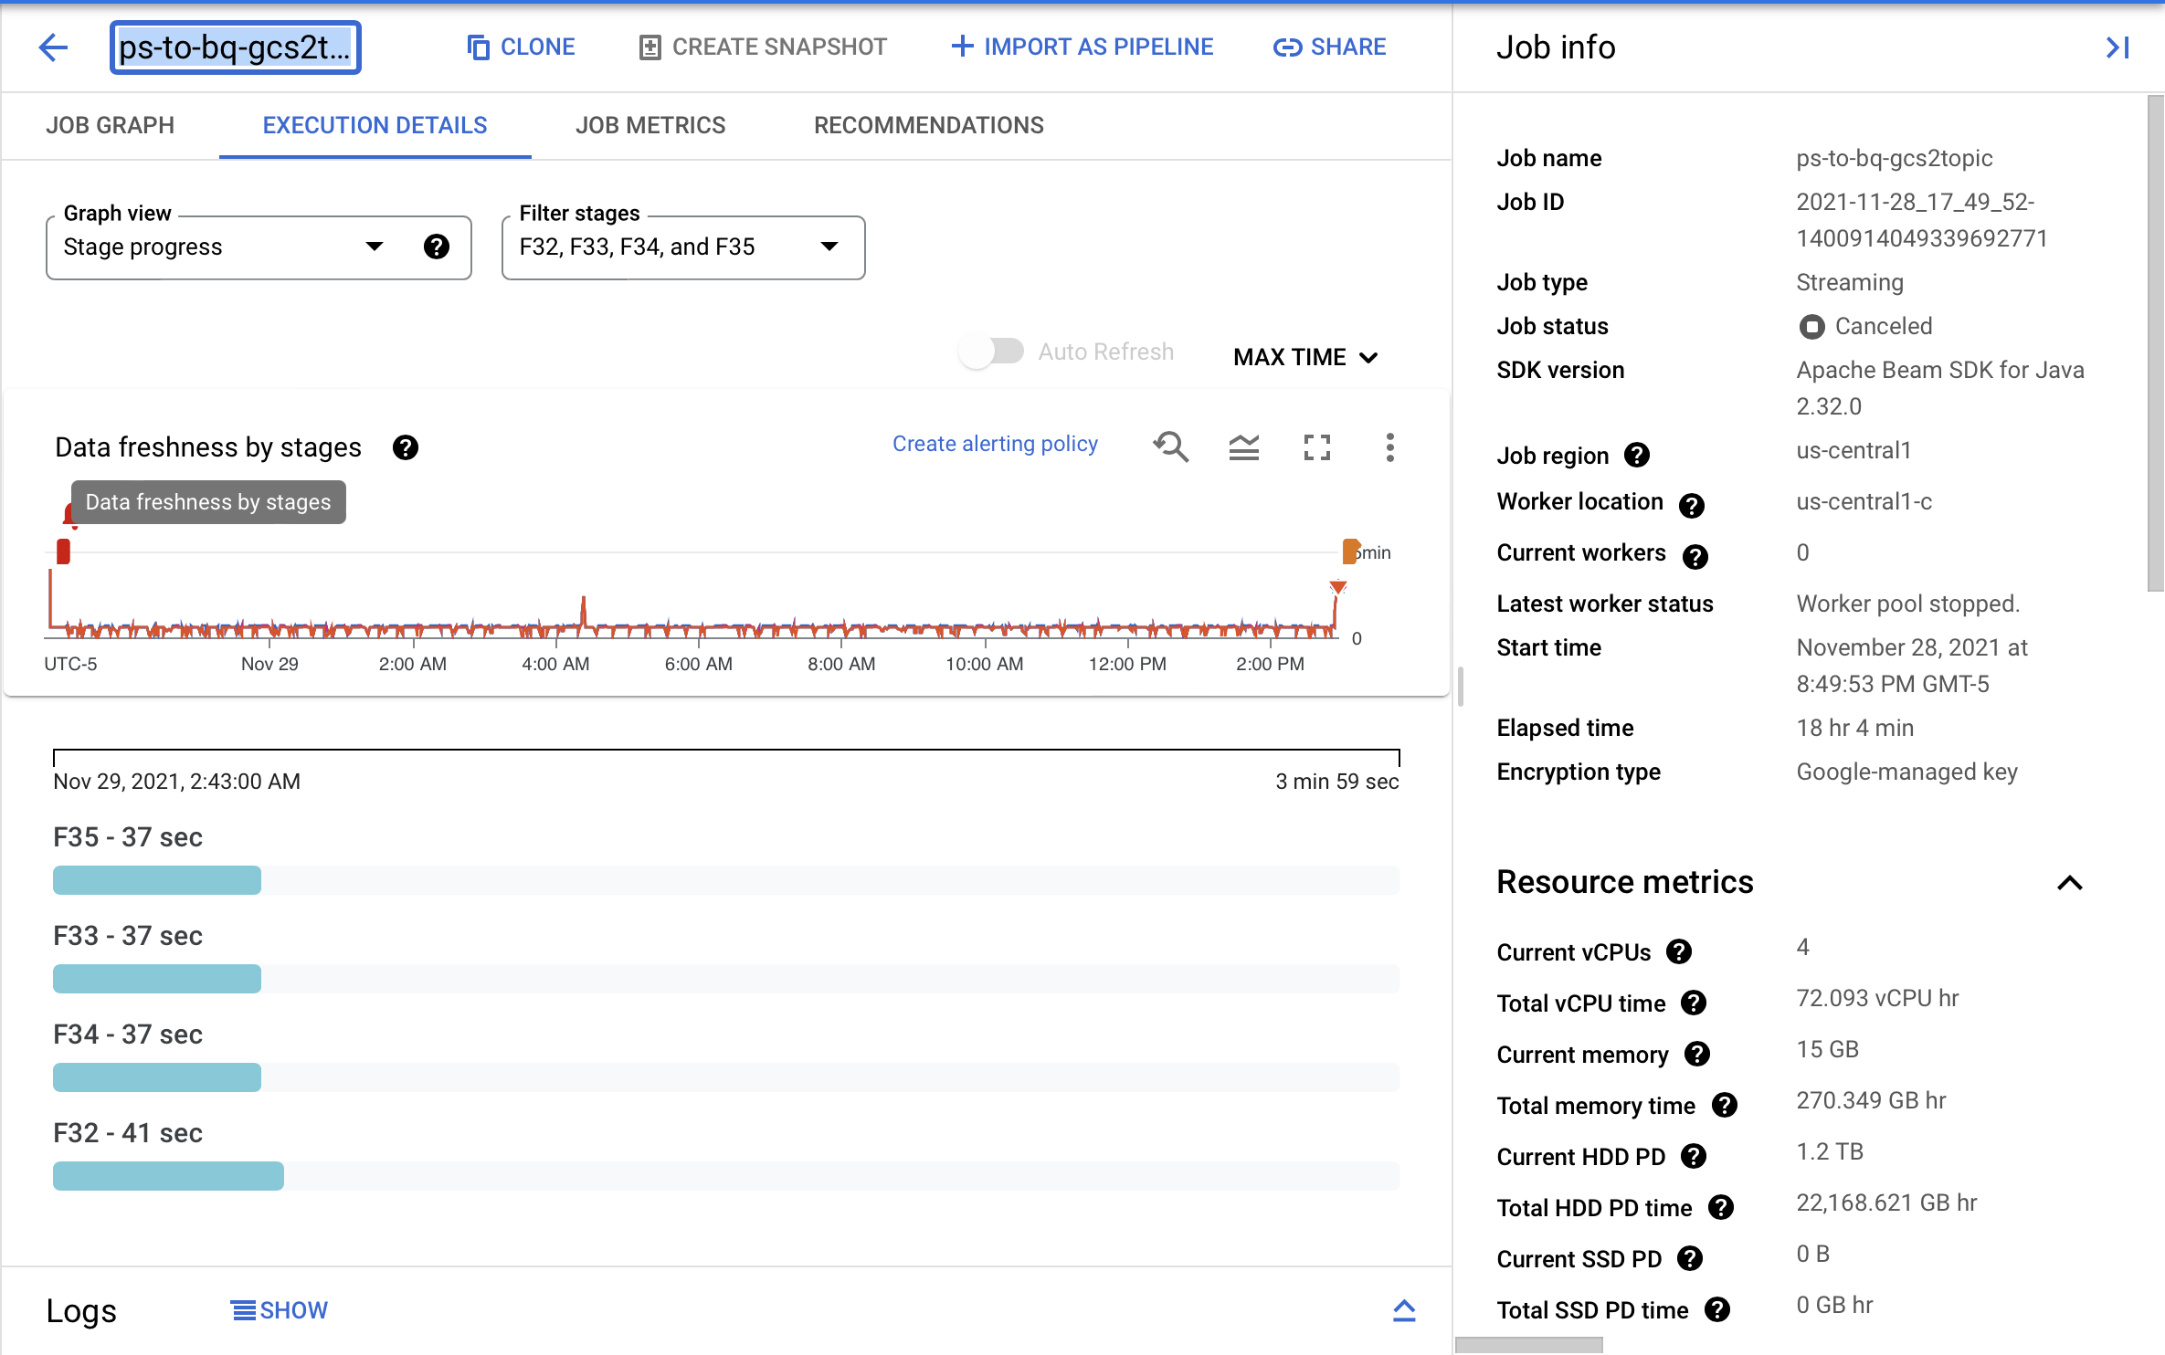
Streaming Dataflow Job ps-to-bq-gcs2topic was scheduled to move the data from Pub/Sub Topic to Big Query
Note-We cancelled the Job after running it for 18 hours

Slide 8
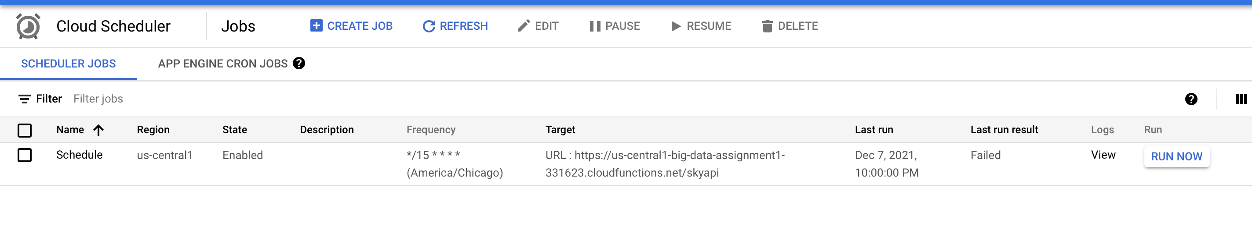
Cloud Scheduler Schedule was created to trigger cloud function in every 15 minutes

Slide 9
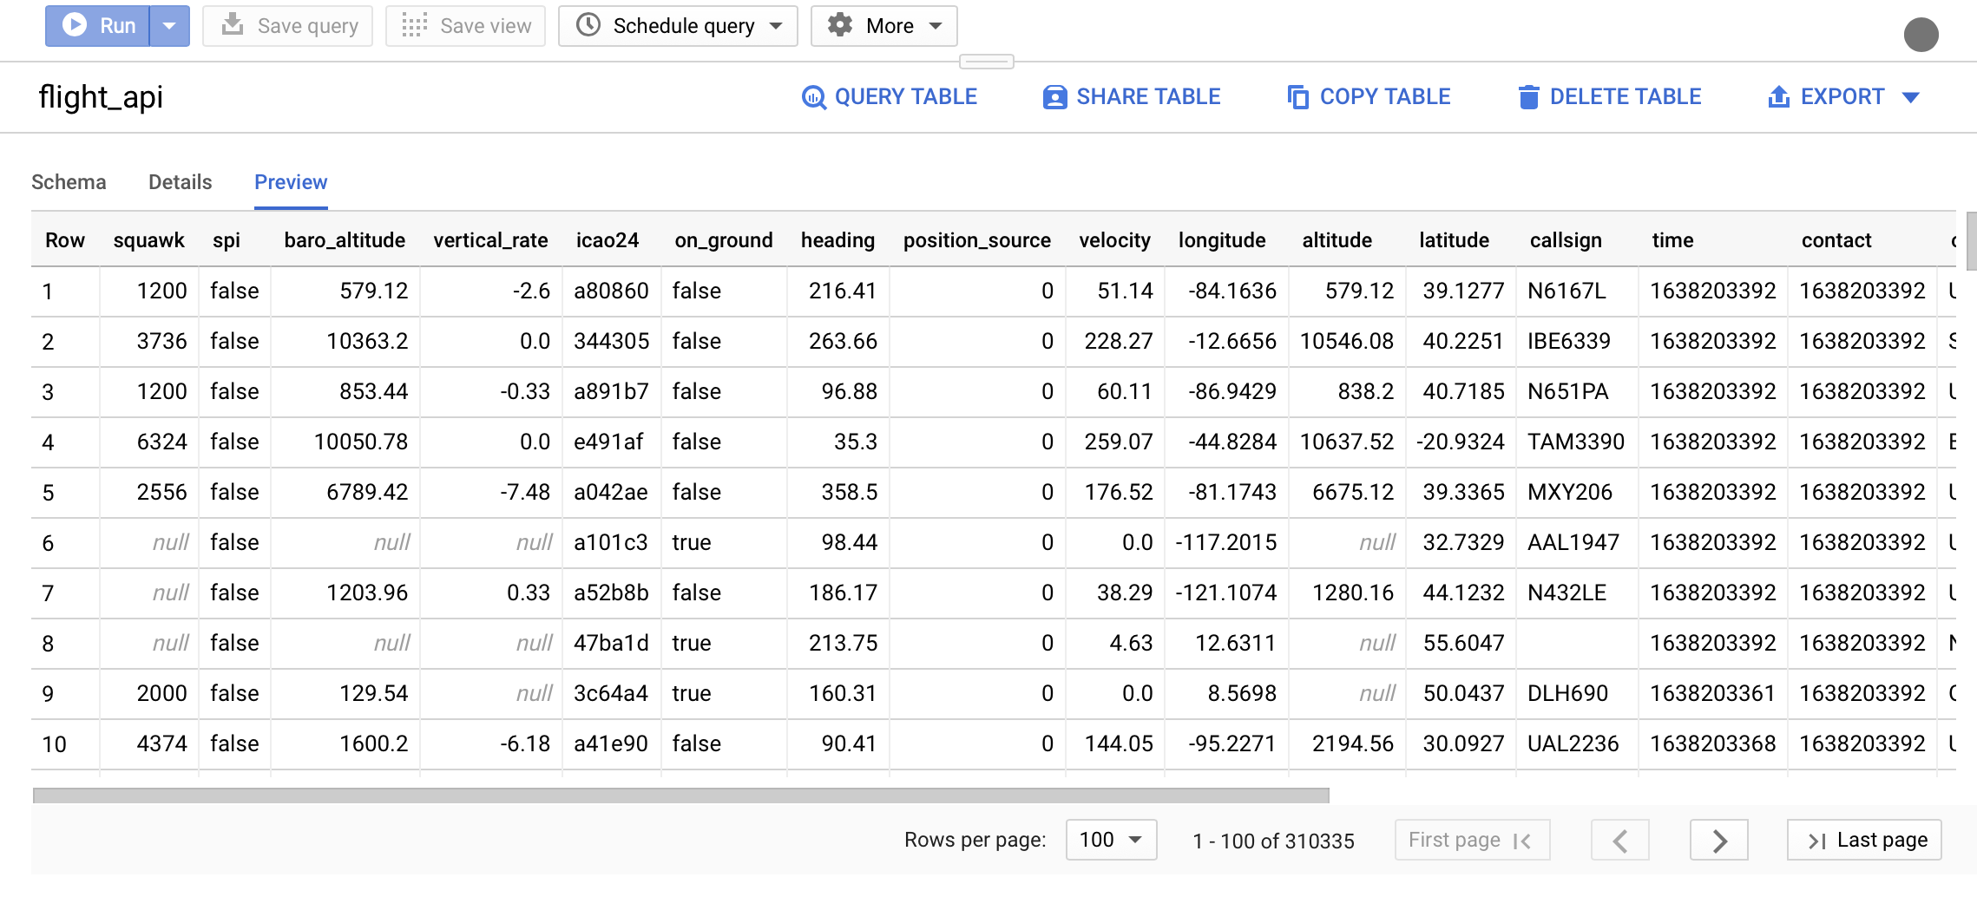
Data from Pub/Sub was flowing to Big Query Table flight_api. After running the jobs for 18 hours, we had around 310K data records

Slide 10
Streaming Data Analysis For an origin-destination pair and for any 2-hour time window

Slide 11
Additional Table Downloaded from Various Website to make it more meaningful

Slide 12
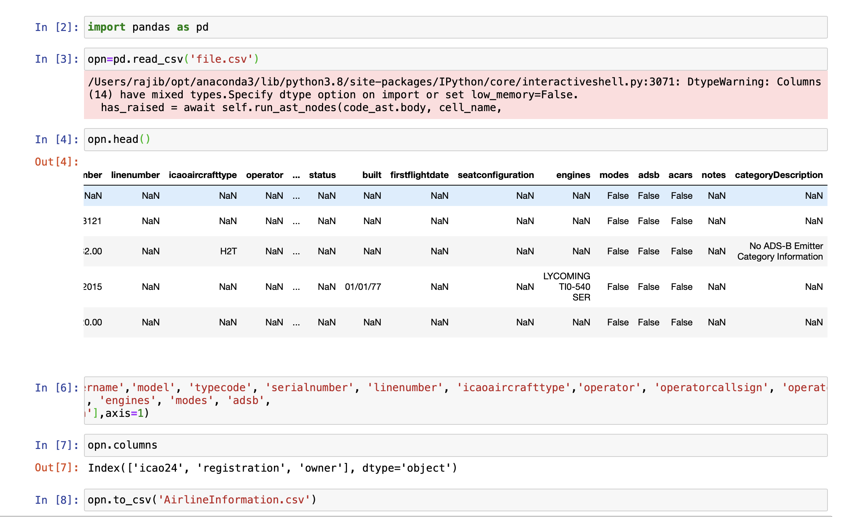
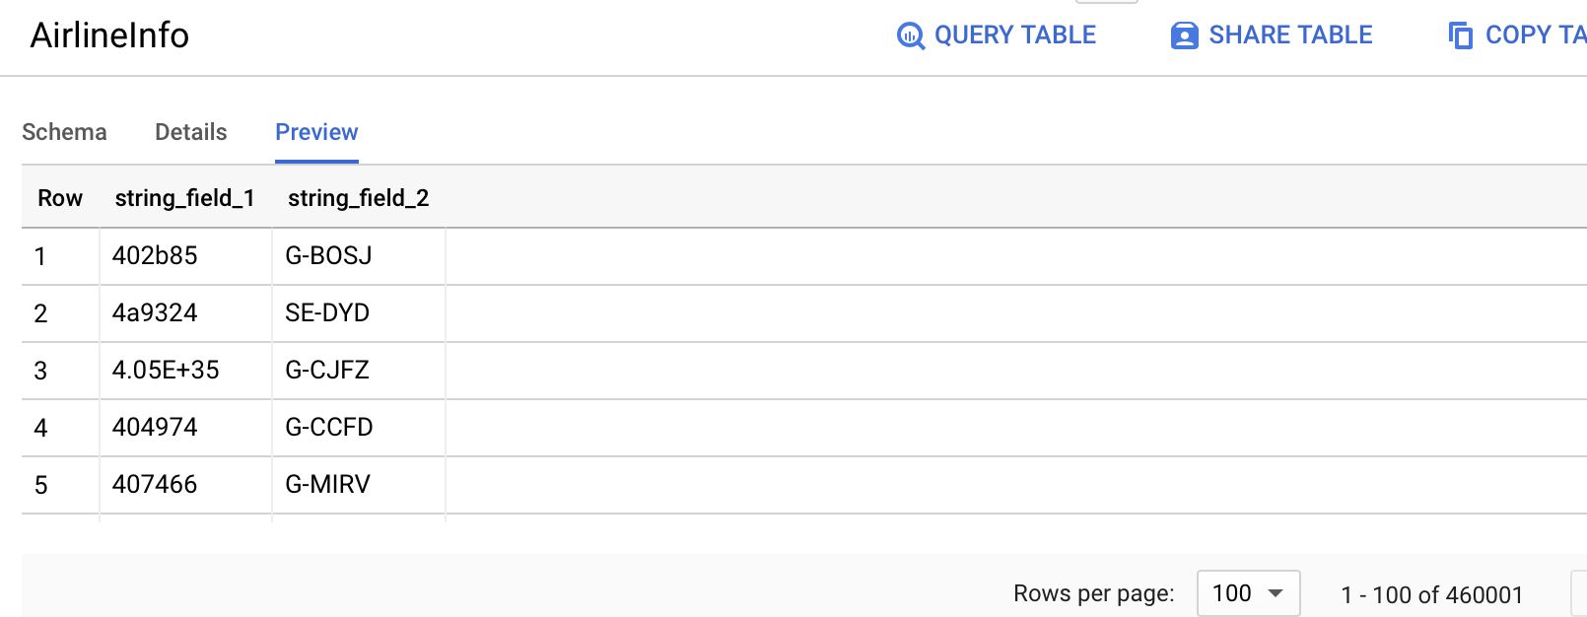
Metadata Downloaded from Open-Sky website
Removed additional Columns using Python as Excel was not able to perform actions because of huge set of Data
ICA024 and Tail Number was Uploaded to Big Query after modifications
https://opensky-network.org/datasets/metadata/

Slide 13
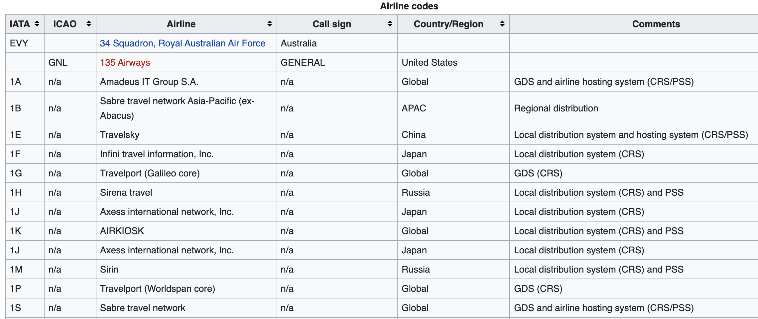
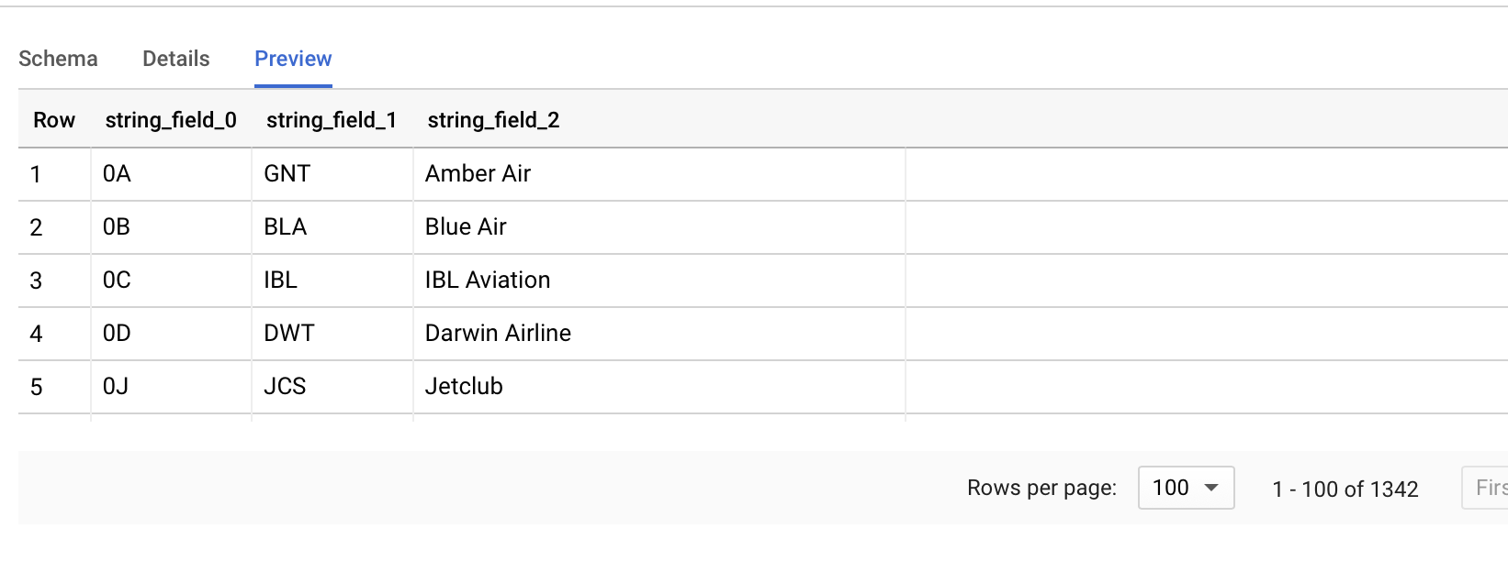
IATA and ICAO CODE Downloaded from Wikipedia
IATA Code and ICAO Code was present in Wikipedia
IATA, ICAO Code and Airline Information was uploaded in Big Query
https://en.wikipedia.org/wiki/List_of_airline_codes

Slide 14
Data Wrangling- Streaming Data contained incomplete information

Slide 15
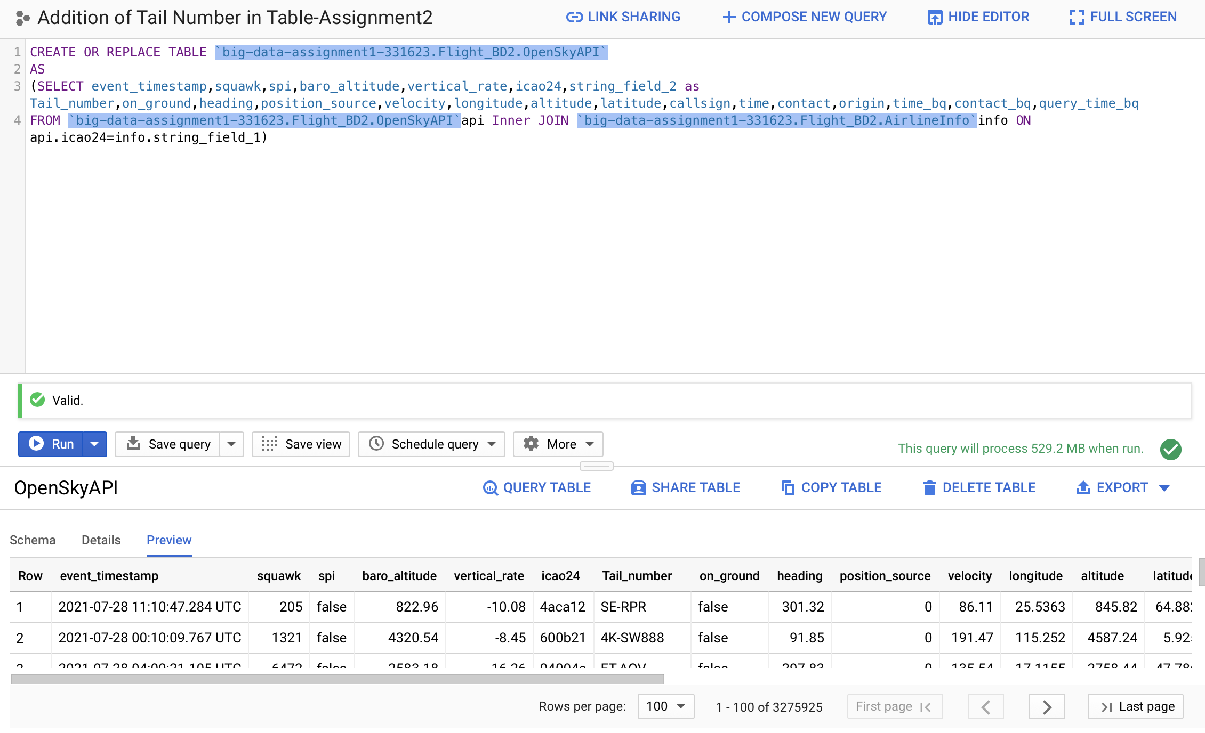
Addition of Tail Number
Added Tail Number in the table with respect to ICAO24 while using Open-Sky Metadata table ‘AirlineInfo’

Slide 16
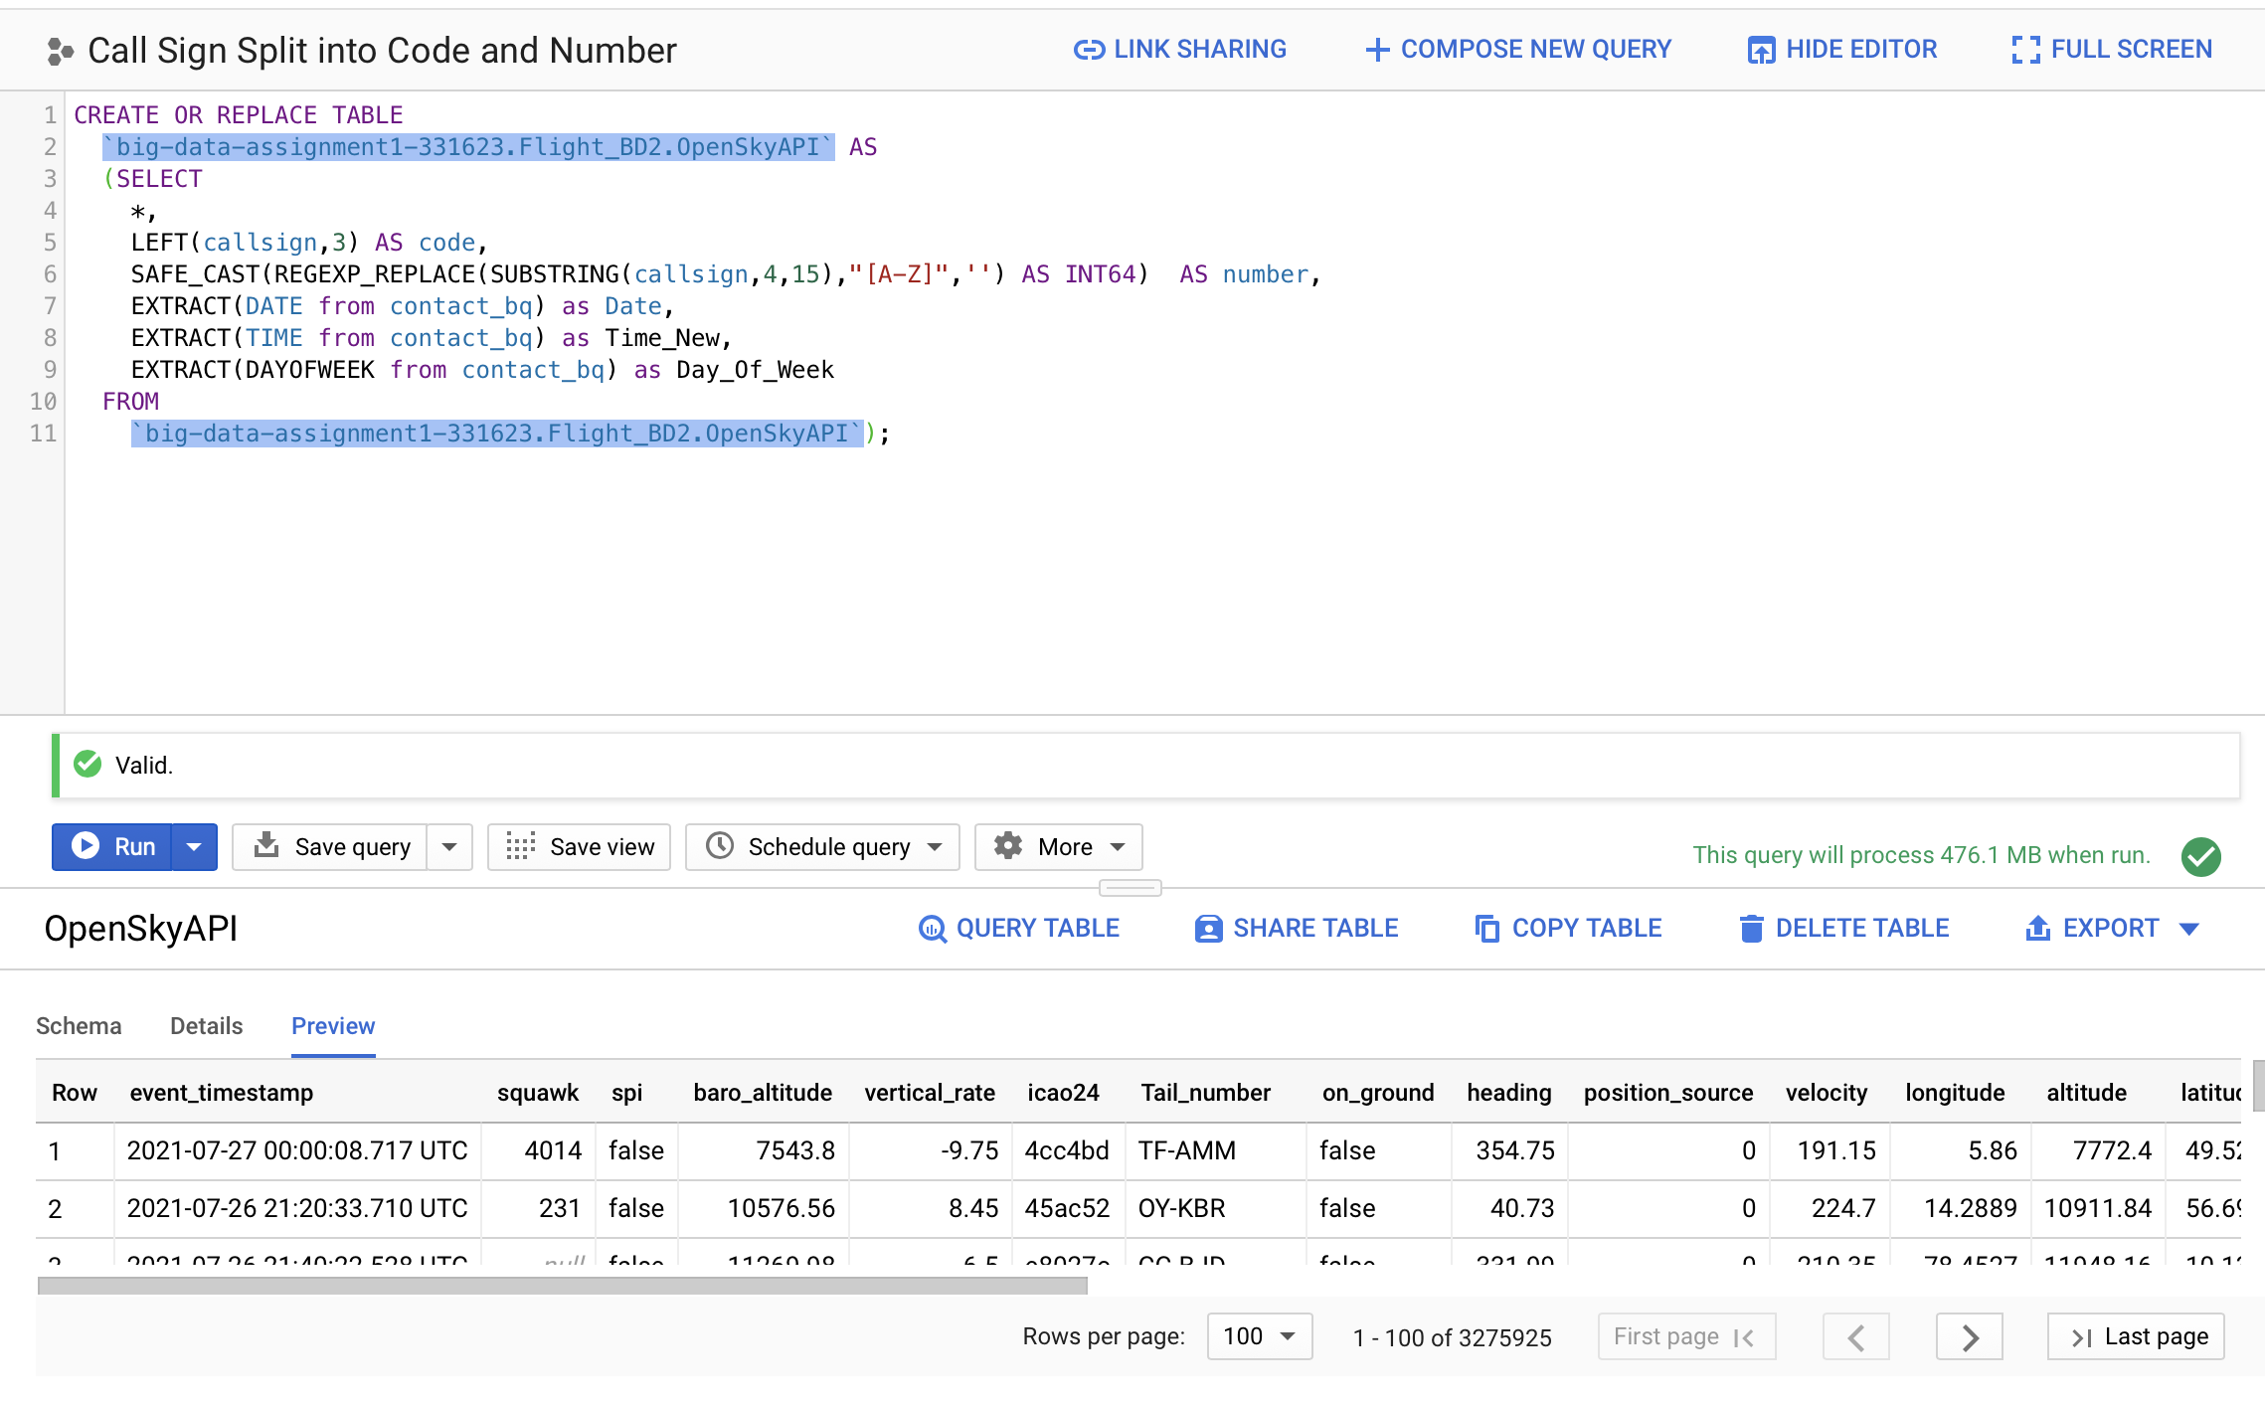
Call Sign Split and Extraction of Date, Time and Day of Week
Performed Call Split to extract IATA Code and Flight Number. Extracted Date, Time and Day of Week. Converted Flight Number to Integer using SAFE_CAST

Slide 17
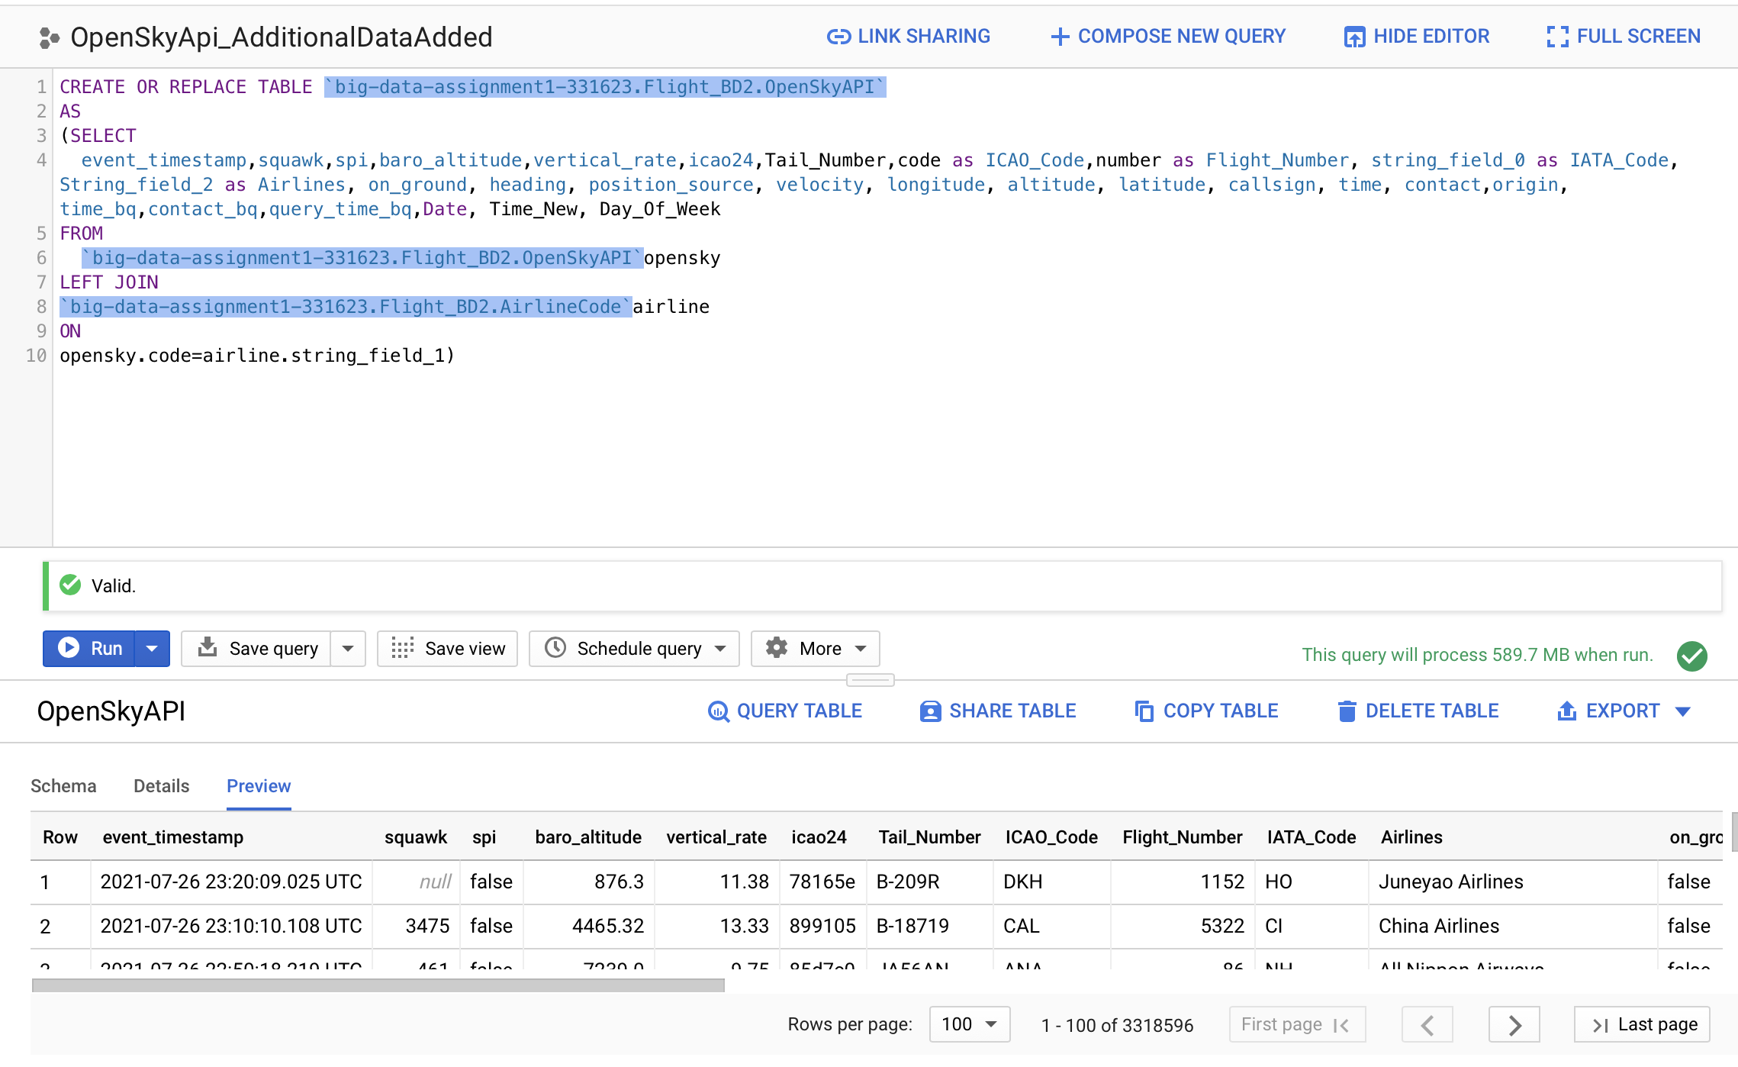
Adding Airline Name in the Table
Used Wikipedia extracted ‘AirlineCode’ table IATA Code and IATA Code, after split from Callsign, to perform a join and extract Airline Information

Slide 18
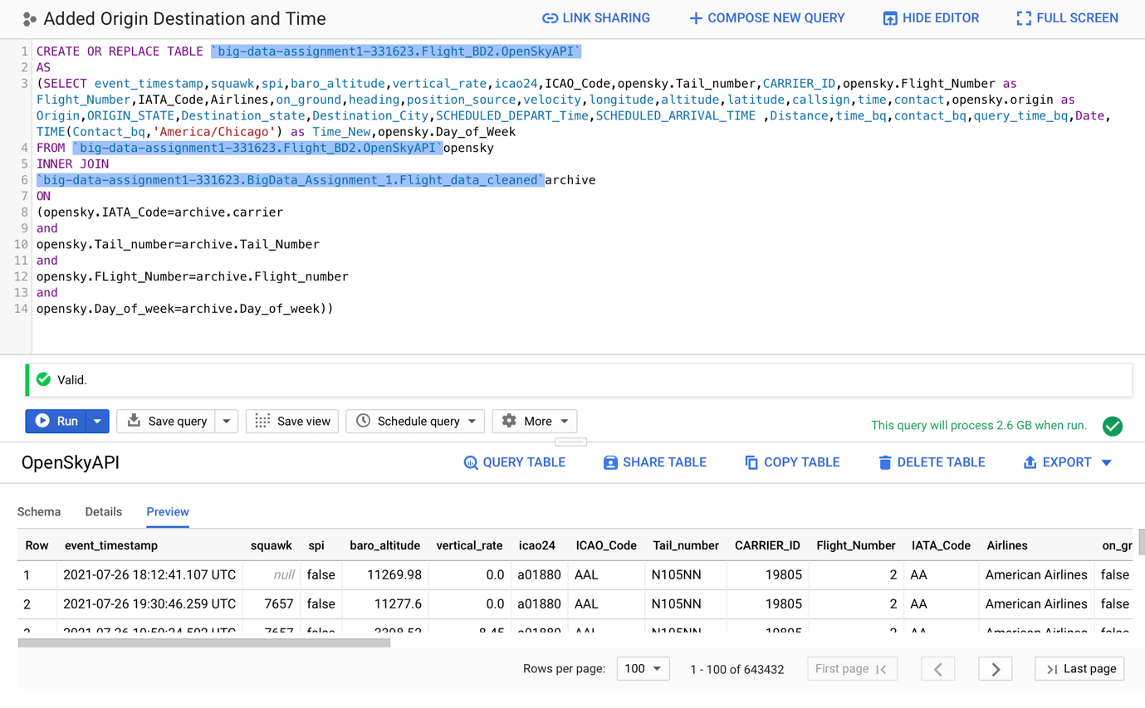
Adding CarrierID Origin Destination Scheduled Departure-Arrival Time
Used Batch Data to add Carrier ID, Origin, Destination, Scheduled Departure Time, Scheduled Arrival Time and Converted UTC time of Streaming Data to CST

Slide 19
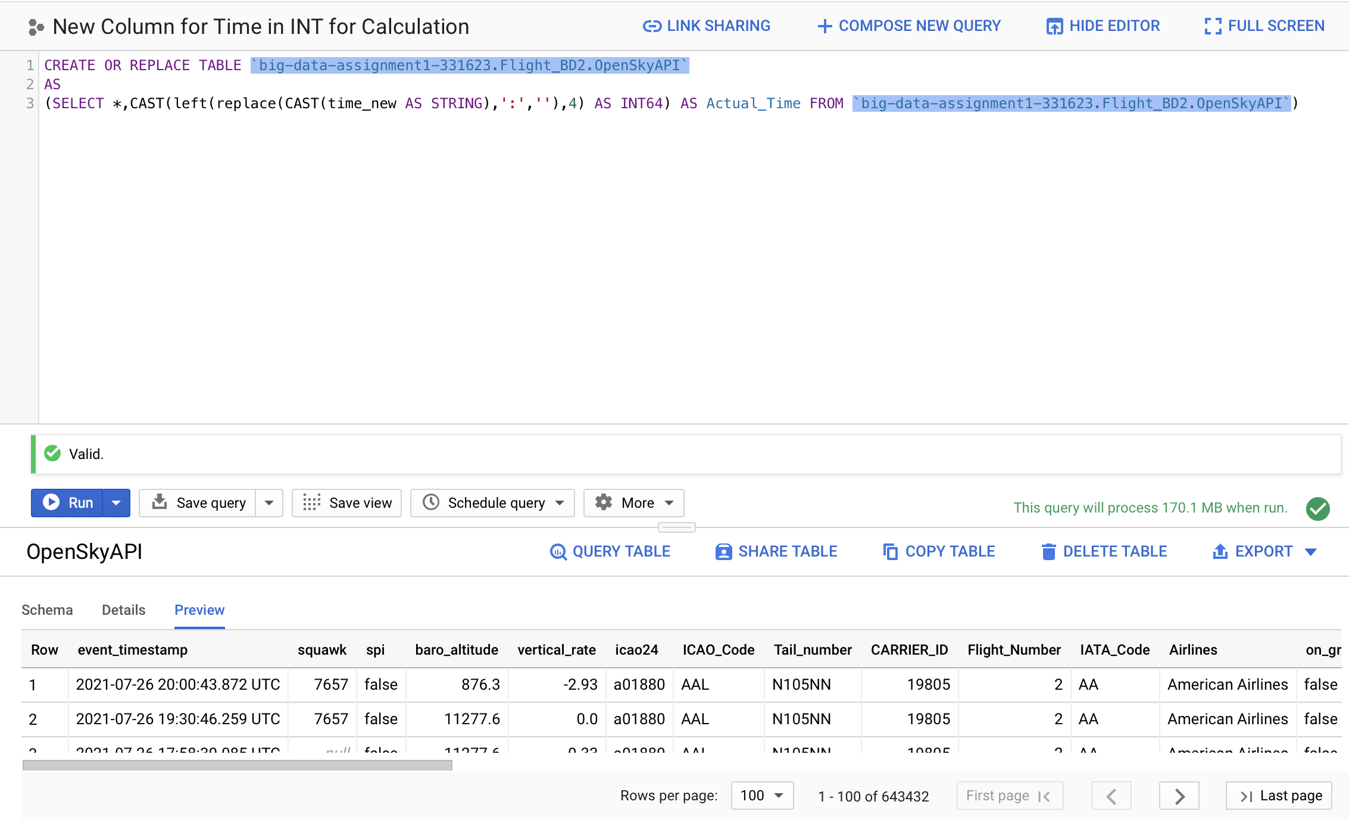
Converting Time schema
Batch Data Time Column is in Integer data type. For easy Calculation, converting the Time for Streaming Data into Integer type

Slide 20
List the planes and Airlines that are on ground at the origin, ascending, in-route (cruising at a fixed altitude), descending, and on ground at the destination
Query to find the Individual Flight Status
Status of flights as per Airlines
SELECT DISTINCT(TAIL_NUMBER) as Tail_Number,IATA_Code as Carrier,Carrier_ID,Airlines,Scheduled_Arrival_Time,ORIGIN_STATE, DESTINATION_STATE,Scheduled_Depart_Time, Day_Of_week,
CASE WHEN on_ground=true and Scheduled_Depart_Time<=(Actual_Time+30) THEN 'At Origin'
WHEN on_ground=true and (Scheduled_Arrival_Time-30)>=Actual_Time THEN 'At Destination'
WHEN on_ground=false and vertical_rate=0 THEN 'Cruising'
WHEN on_ground=false and vertical_rate>0 THEN 'Ascending'
WHEN on_ground=false and vertical_rate<0 THEN 'Descending'
ELSE 'Missing Data' END AS Status
FROM `big-data-assignment1-331623.Flight_BD2.OpenSkyAPI`
WHERE contact_bq BETWEEN '2021-07-27 12:00:00 UTC'AND '2021-07-27 14:00:00 UTC'
ORDER BY Airlines
Select Distinct(Airlines),Status,Count(Airlines) OVER(Partition by Airlines,Status) as Number_Of_Flights
From
(SELECT DISTINCT(TAIL_NUMBER) as Tail_Number,IATA_Code as Carrier,Carrier_ID,Airlines,Scheduled_Arrival_Time,ORIGIN_STATE, DESTINATION_STATE,Scheduled_Depart_Time,Day_Of_week,
CASE WHEN on_ground=true and Scheduled_Depart_Time<=(Actual_Time+30) THEN 'At Origin'
WHEN on_ground=true and (Scheduled_Arrival_Time-30)>=Actual_Time THEN 'At Destination'
WHEN on_ground=false and vertical_rate=0 THEN 'Cruising'
WHEN on_ground=false and vertical_rate>0 THEN 'Ascending'
WHEN on_ground=false and vertical_rate<0 THEN 'Descending'
ELSE 'Missing Data' END AS Status
FROM `big-data-assignment1-331623.Flight_BD2.OpenSkyAPI`
WHERE contact_bq BETWEEN '2021-07-27 12:00:00 UTC'AND '2021-07-27 14:00:00 UTC'
ORDER BY Airlines)

Slide 21
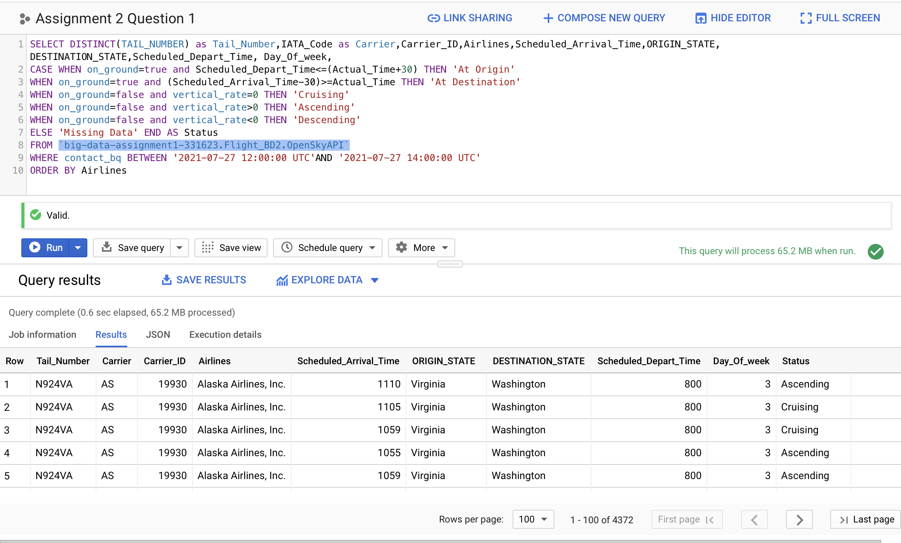
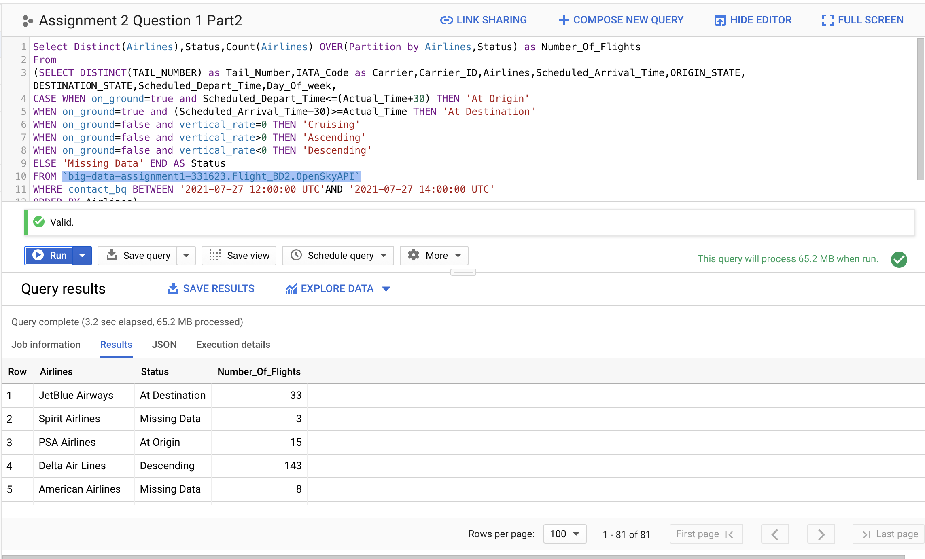
List the planes and Airlines that are on ground at the origin, ascending, in-route (cruising at a fixed altitude), descending, and on ground at the destination

Slide 22
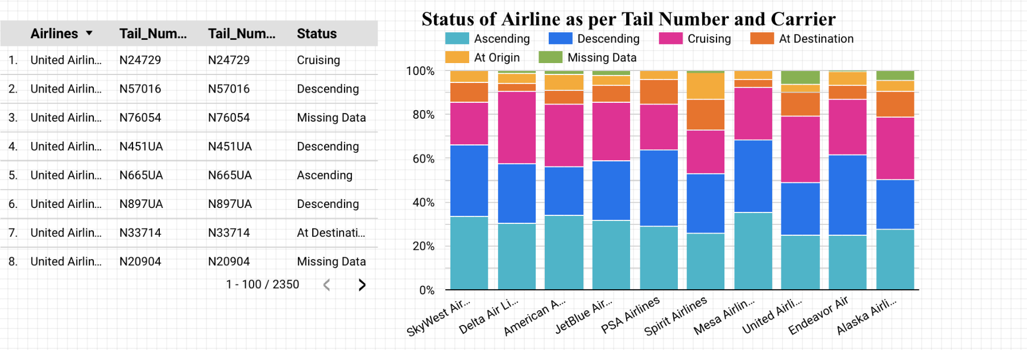
List the planes and Airlines that are on ground at the origin, ascending, in-route (cruising at a fixed altitude), descending, and on ground at the destination
For the 2-hour window, we can see that most flights are ascending, descending and cruising. Only limited flights were at Origin or at Destination. For United Airlines and American Airlines, we can see that most of the flights are cruising.
In streaming data, we have missing values for on ground and vertical rate, which are represented as missing data in the chart

Slide 23
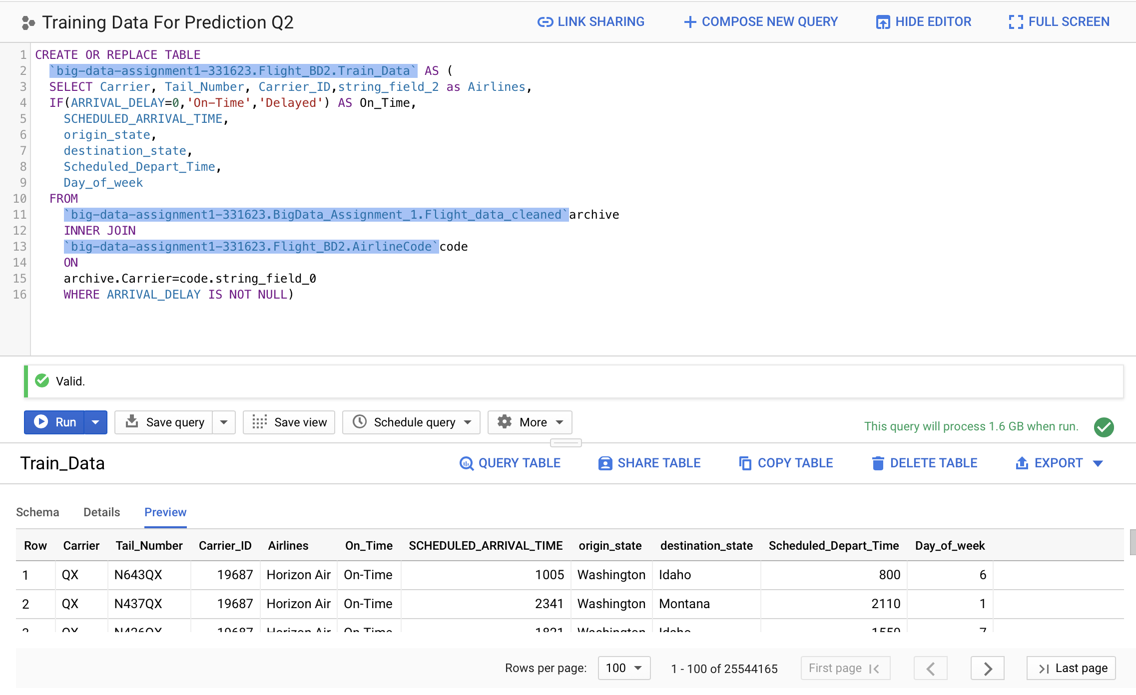
For the same origin-destination pair, airlines, day, and the time window, predict which flights will be delayed
Query to Create a table which we will use to train our model
CREATE OR REPLACE TABLE
`big-data-assignment1-331623.Flight_BD2.Train_Data` AS (
SELECT Carrier, Tail_Number, Carrier_ID,string_field_2 as Airlines,
IF(ARRIVAL_DELAY=0,'On-Time','Delayed') AS On_Time,
SCHEDULED_ARRIVAL_TIME,
origin_state,
destination_state,
Scheduled_Depart_Time,
Day_of_week
FROM
`big-data-assignment1-331623.BigData_Assignment_1.Flight_data_cleaned`archive
INNER JOIN
`big-data-assignment1-331623.Flight_BD2.AirlineCode`code
ON
archive.Carrier=code.string_field_0
WHERE ARRIVAL_DELAY IS NOT NULL)

Slide 24
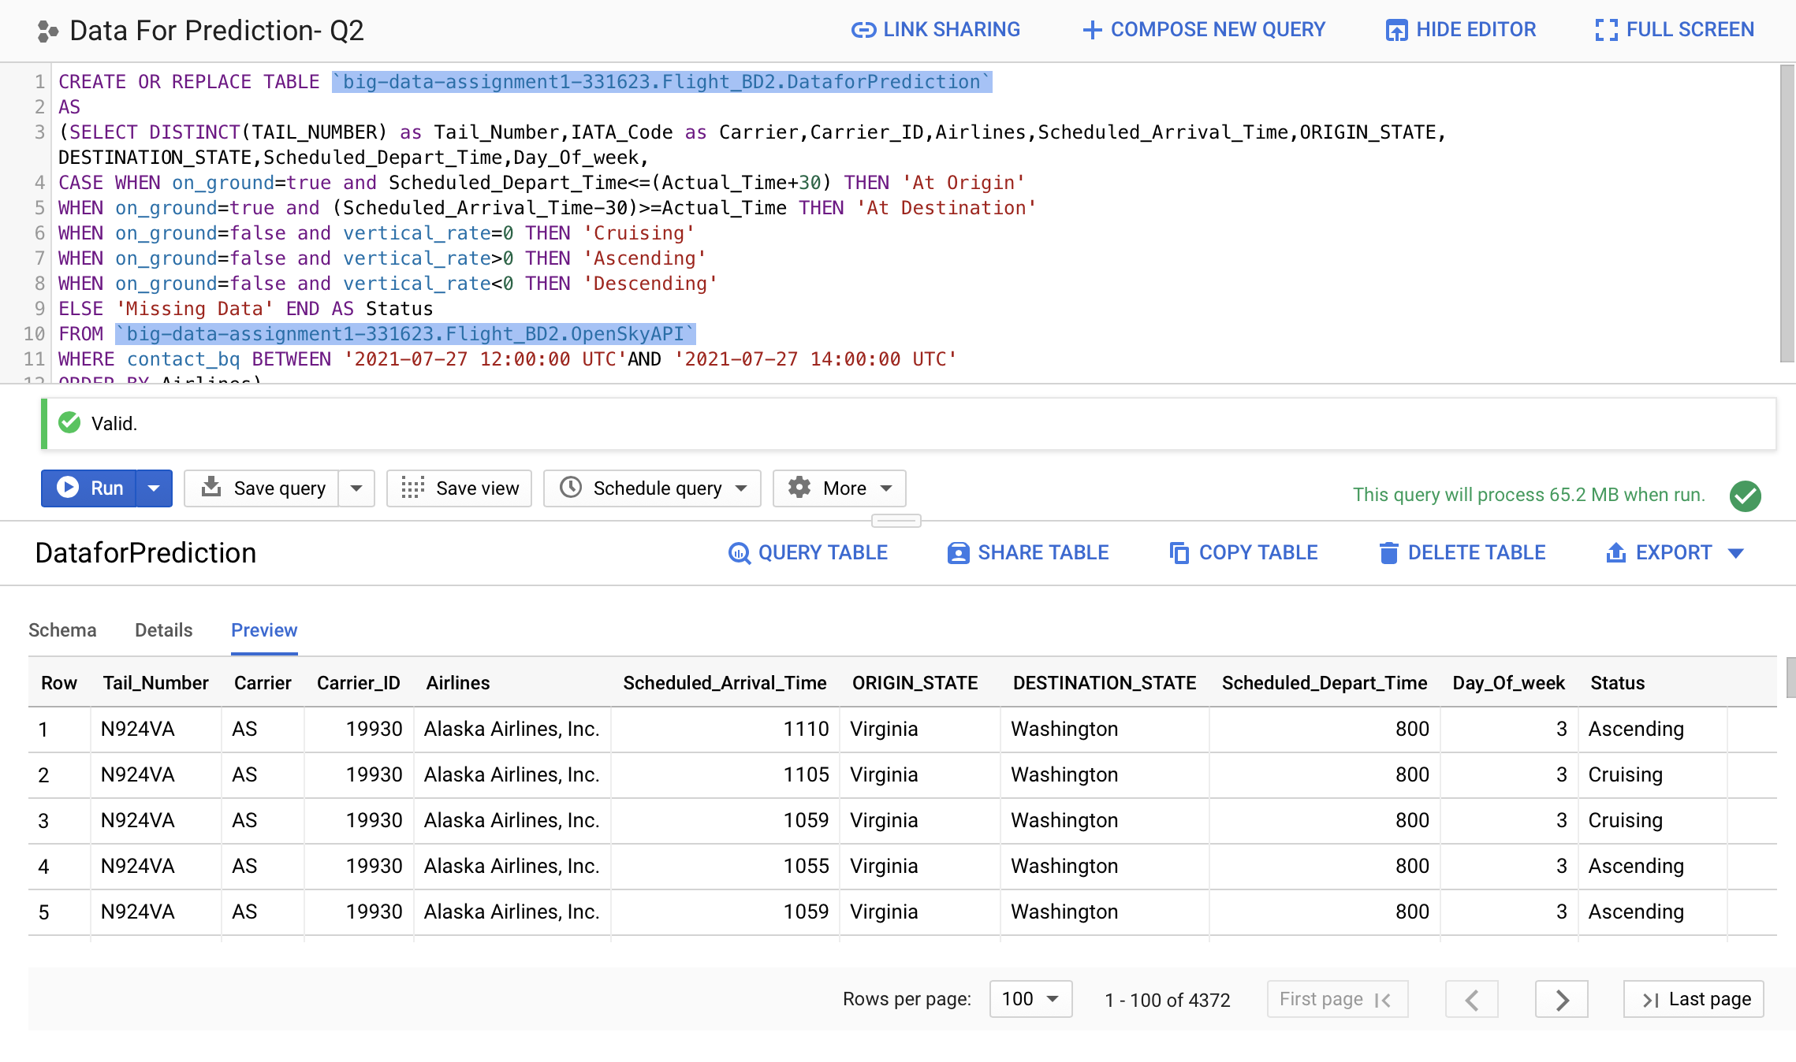
For the same origin-destination pair, airlines, day, and the time window, predict which flights will be delayed
Query to Create Table for Question 1 for which we need to do Prediction
CREATE OR REPLACE TABLE `big-data-assignment1-331623.Flight_BD2.DataforPrediction`
AS
(SELECT DISTINCT(TAIL_NUMBER) as Tail_Number,IATA_Code as Carrier,Carrier_ID,Airlines,Scheduled_Arrival_Time,ORIGIN_STATE, DESTINATION_STATE,Scheduled_Depart_Time,Day_Of_week,
CASE WHEN on_ground=true and Scheduled_Depart_Time<=(Actual_Time+30) THEN 'At Origin'
WHEN on_ground=true and (Scheduled_Arrival_Time-30)>=Actual_Time THEN 'At Destination'
WHEN on_ground=false and vertical_rate=0 THEN 'Cruising'
WHEN on_ground=false and vertical_rate>0 THEN 'Ascending'
WHEN on_ground=false and vertical_rate<0 THEN 'Descending'
ELSE 'Missing Data' END AS Status
FROM `big-data-assignment1-331623.Flight_BD2.OpenSkyAPI`
WHERE contact_bq BETWEEN '2021-07-27 12:00:00 UTC'AND '2021-07-27 14:00:00 UTC'
ORDER BY Airlines)

Slide 25
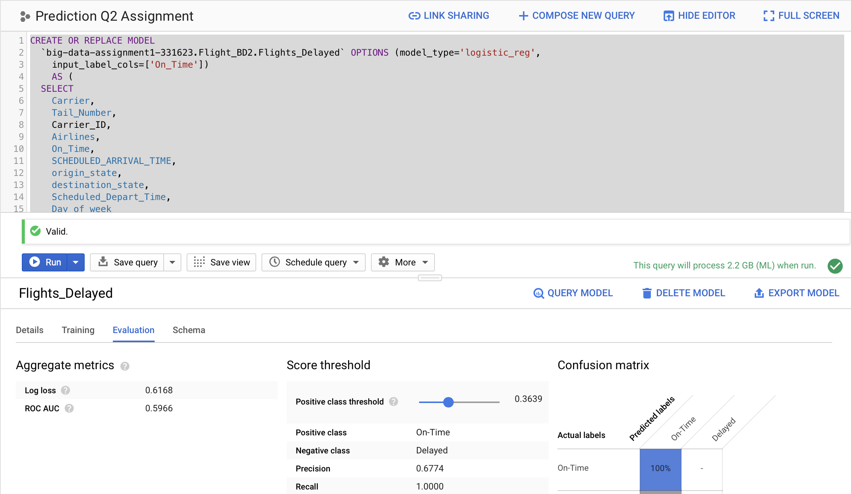
For the same origin-destination pair, airlines, day, and the time window, predict which flights will be delayed
Training the Model on Train Data
CREATE OR REPLACE MODEL
`big-data-assignment1-331623.Flight_BD2.Flights_Delayed` OPTIONS (model_type='logistic_reg',
input_label_cols=['On_Time'])
AS (
SELECT
Carrier,
Tail_Number,
Carrier_ID,
Airlines,
On_Time,
SCHEDULED_ARRIVAL_TIME,
origin_state,
destination_state,
Scheduled_Depart_Time,
Day_of_week
FROM
`big-data-assignment1-331623.Flight_BD2.Train_Data`)

Slide 26
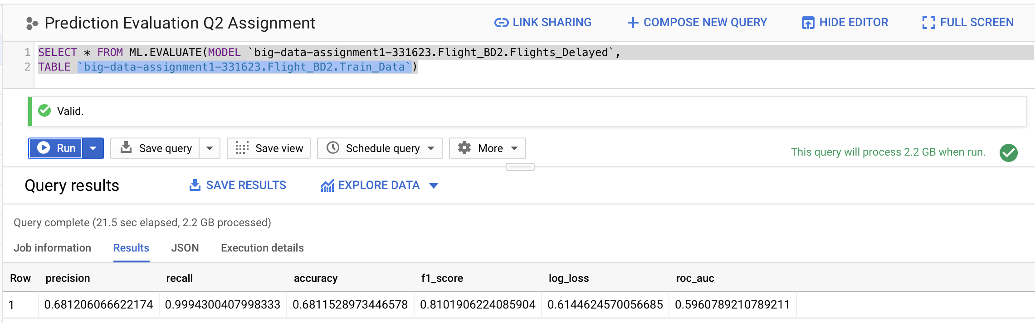
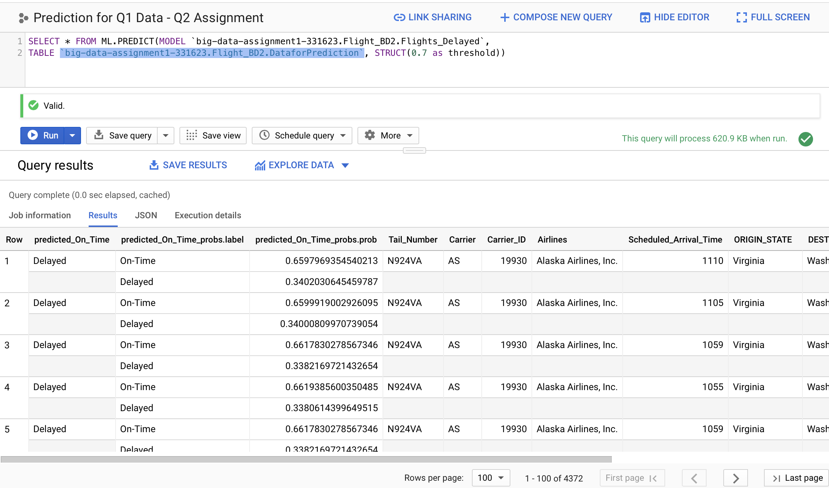
For the same origin-destination pair, airlines, day, and the time window, predict which flights will be delayed
Model Evaluation
SELECT * FROM ML.EVALUATE(MODEL `big-data-assignment1-331623.Flight_BD2.Flights_Delayed`,
TABLE `big-data-assignment1-331623.Flight_BD2.Train_Data`)
Model Prediction with threshold as 0.7
SELECT * FROM ML.PREDICT(MODEL `big-data-assignment1-331623.Flight_BD2.Flights_Delayed`,
TABLE `big-data-assignment1-331623.Flight_BD2.DataforPrediction`, STRUCT(0.7 as threshold))

Slide 27
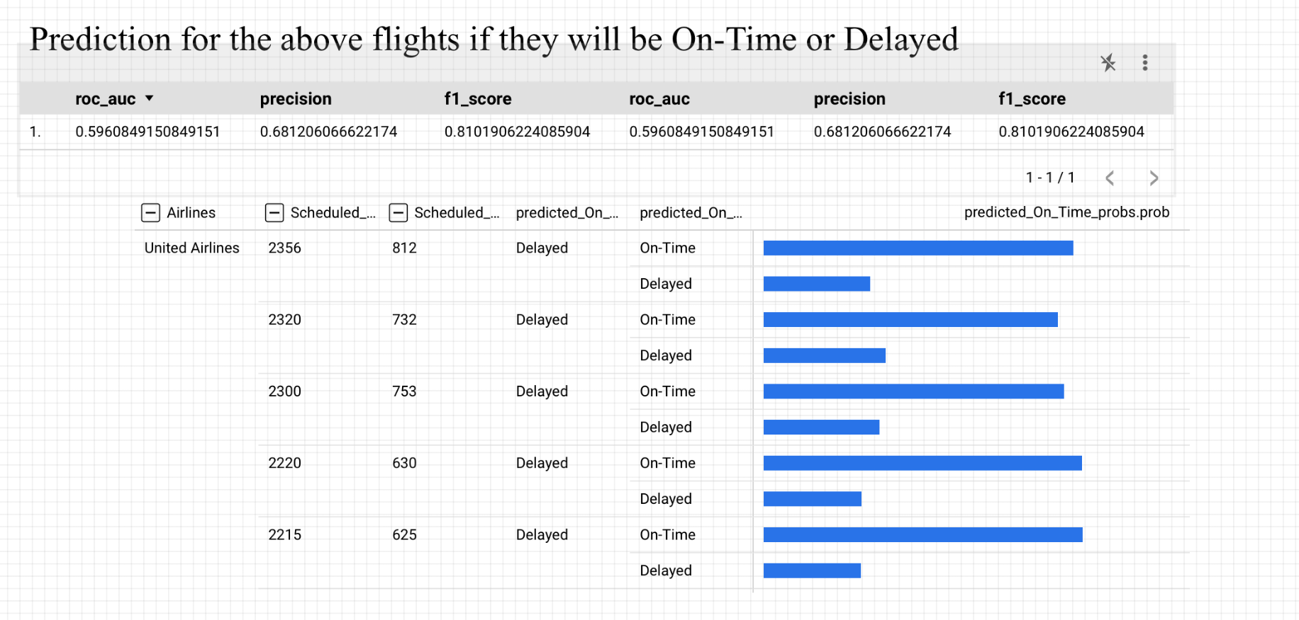
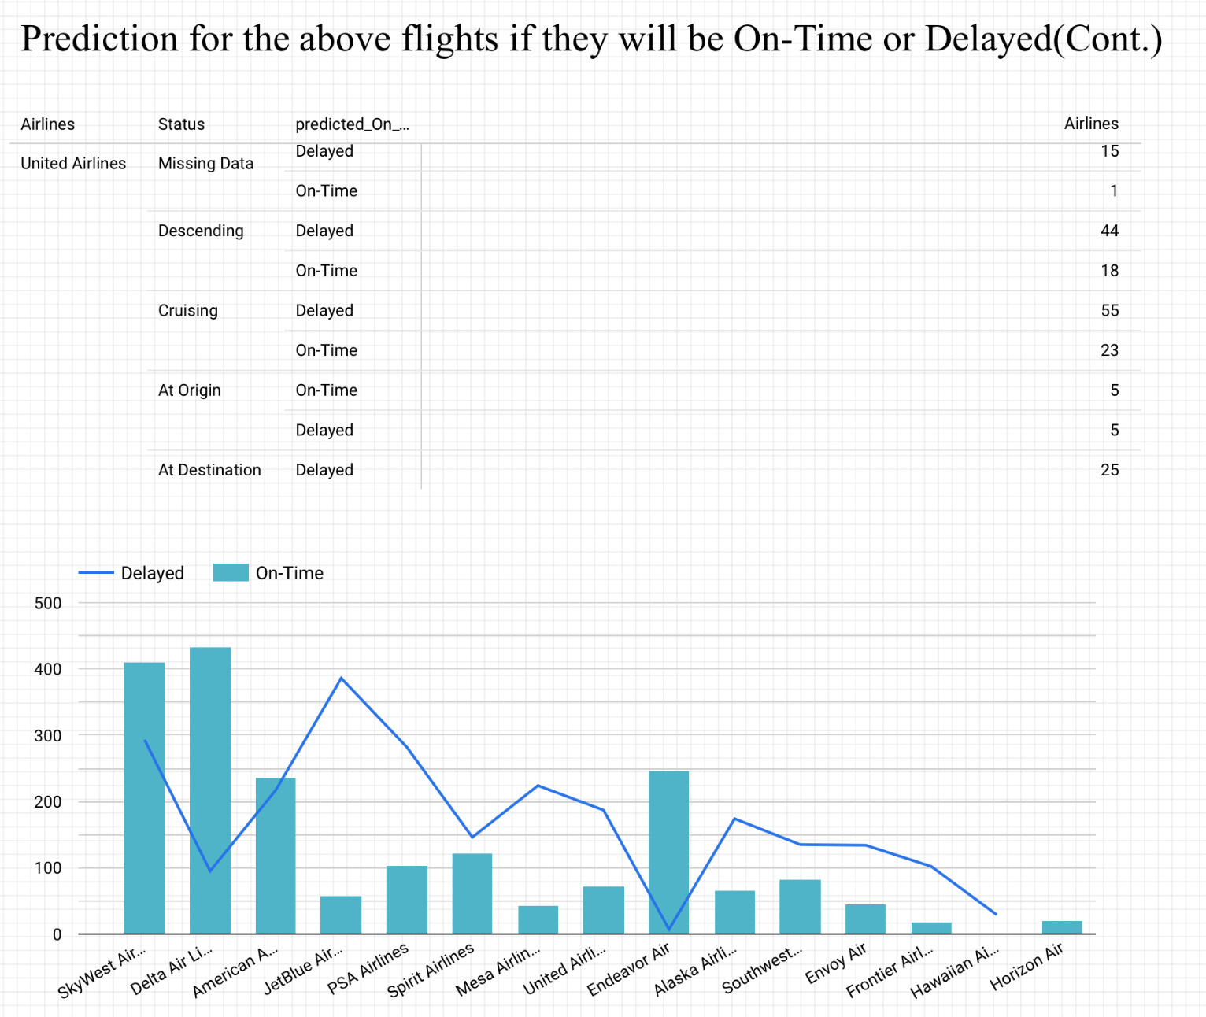
For the same origin-destination pair, airlines, day, and the time window, predict which flights will be delayed
We trained the model using archive data and predicted flight status for the same origin-destination pair and time window with a threshold of 0.7.
From prediction, we can say that Delta Air Lines flights are the most punctual, and there are very few delayed flights. American Airlines' on-time flights and delayed flights seem to be similar. United Airlines has very few punctual flights. Maximum of its flights are running late

Slide 28
Streaming Data Analysis Develop models to predict the estimated cost and profit for any given flight for an origin destination pair and airlines

Slide 29
Additional Table Downloaded from Various Website to make it more meaningful

Slide 30
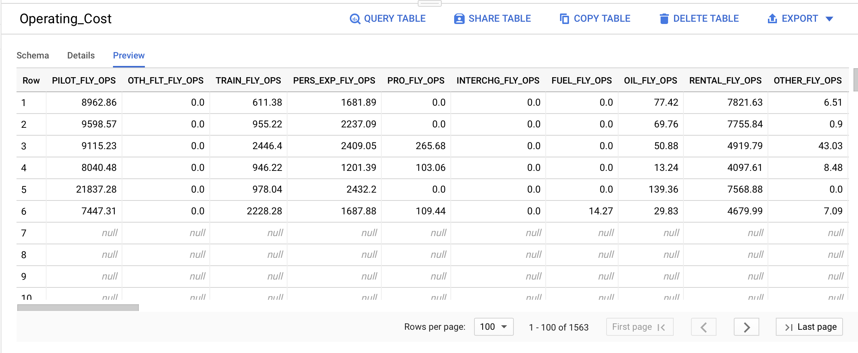
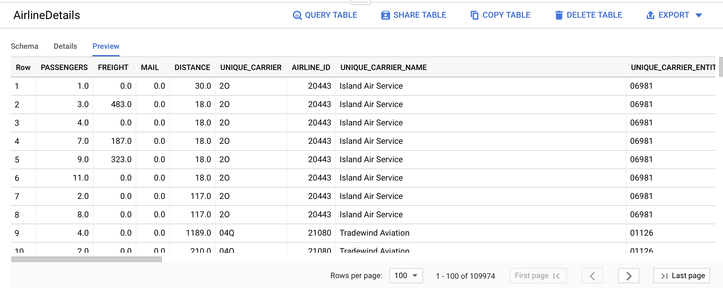
Financial and Carrier Statistics table From Bureau of Transport Statistics
Carrier Statistics- https://transtats.bts.gov/DL_SelectFields.asp?gnoyr_VQ=FMF&QO_fu146_anzr=Nv4%20Pn44vr45
Financial Information- https://transtats.bts.gov/DL_SelectFields.asp?gnoyr_VQ=FMK&QO_fu146_anzr=Nv4%20Pn44vr4%20Sv0n0pvny

Slide 31
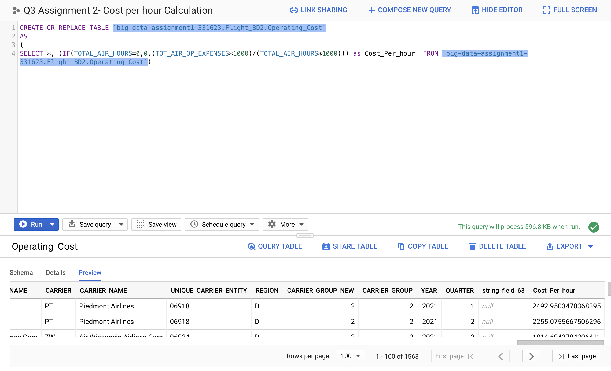
Financial and Carrier Statistics table From Bureau of Transport Statistics
BTS data had Total Operating Cost and Air-Time in 1000s. Calculated Cost Per Hour Flight by Dividing Total Operating Cost with Air-Time

Slide 32
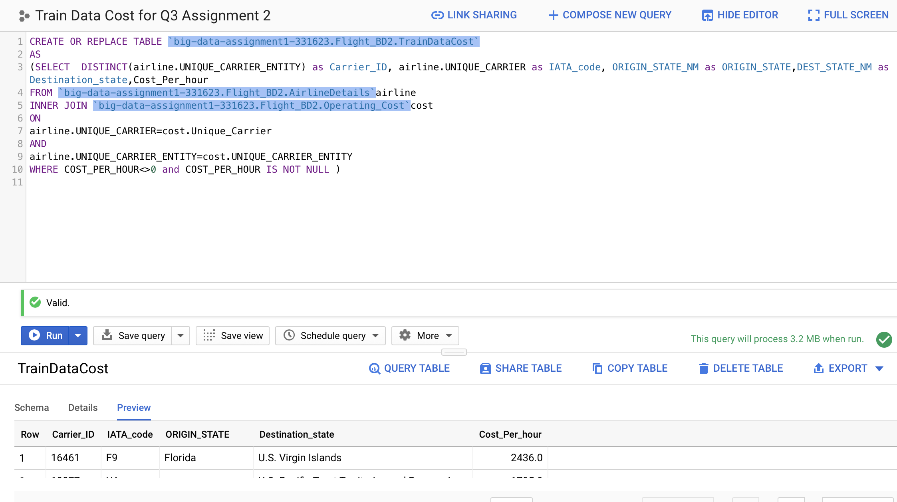
Develop models to predict the estimated cost and profit for any given flight for an origin destination pair and airlines
CREATE OR REPLACE TABLE `big-data-assignment1-331623.Flight_BD2.TrainDataCost`
AS
(SELECT DISTINCT(airline.UNIQUE_CARRIER_ENTITY) as Carrier_ID, airline.UNIQUE_CARRIER as IATA_code, ORIGIN_STATE_NM as ORIGIN_STATE,DEST_STATE_NM as Destination_state,Cost_Per_hour
FROM `big-data-assignment1-331623.Flight_BD2.AirlineDetails`airline
INNER JOIN `big-data-assignment1-331623.Flight_BD2.Operating_Cost`cost
ON
airline.UNIQUE_CARRIER=cost.Unique_Carrier
AND
airline.UNIQUE_CARRIER_ENTITY=cost.UNIQUE_CARRIER_ENTITY
WHERE COST_PER_HOUR<>0 and COST_PER_HOUR IS NOT NULL )
Created a Table TrainDataCost for training the model

Slide 33
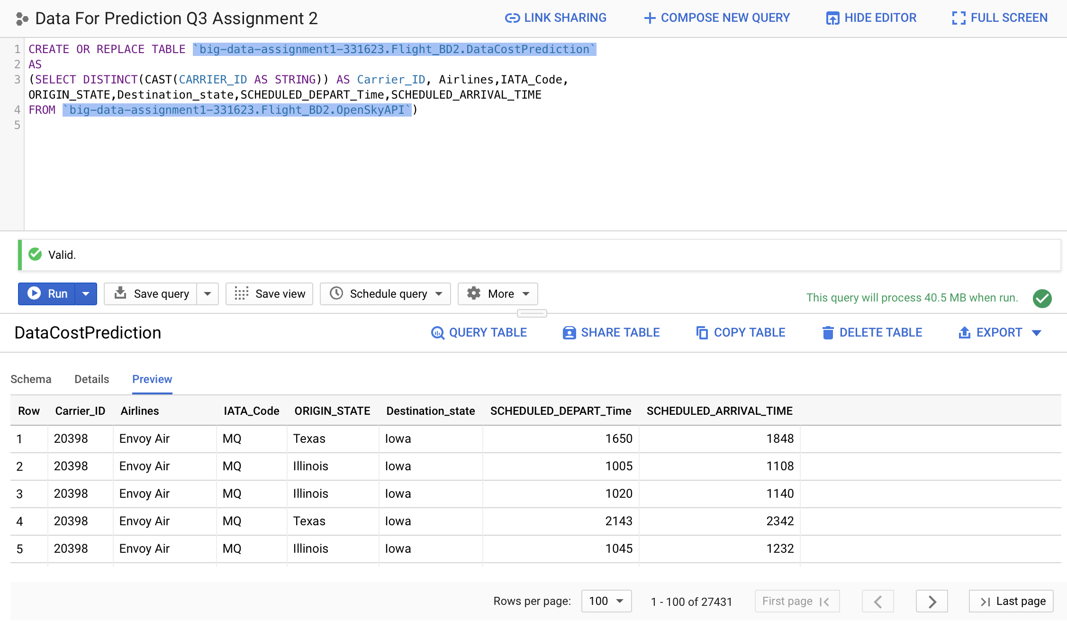
Develop models to predict the estimated cost and profit for any given flight for an origin destination pair and airlines
CREATE OR REPLACE TABLE `big-data-assignment1-331623.Flight_BD2.DataCostPrediction`
AS
(SELECT DISTINCT(CAST(CARRIER_ID AS STRING)) AS Carrier_ID, Airlines,IATA_Code, ORIGIN_STATE,Destination_state,SCHEDULED_DEPART_Time,SCHEDULED_ARRIVAL_TIME
FROM `big-data-assignment1-331623.Flight_BD2.OpenSkyAPI`)
Created a Table DataCostPrediction with necessary columns from all flights in the Streaming data for Prediction

Slide 34
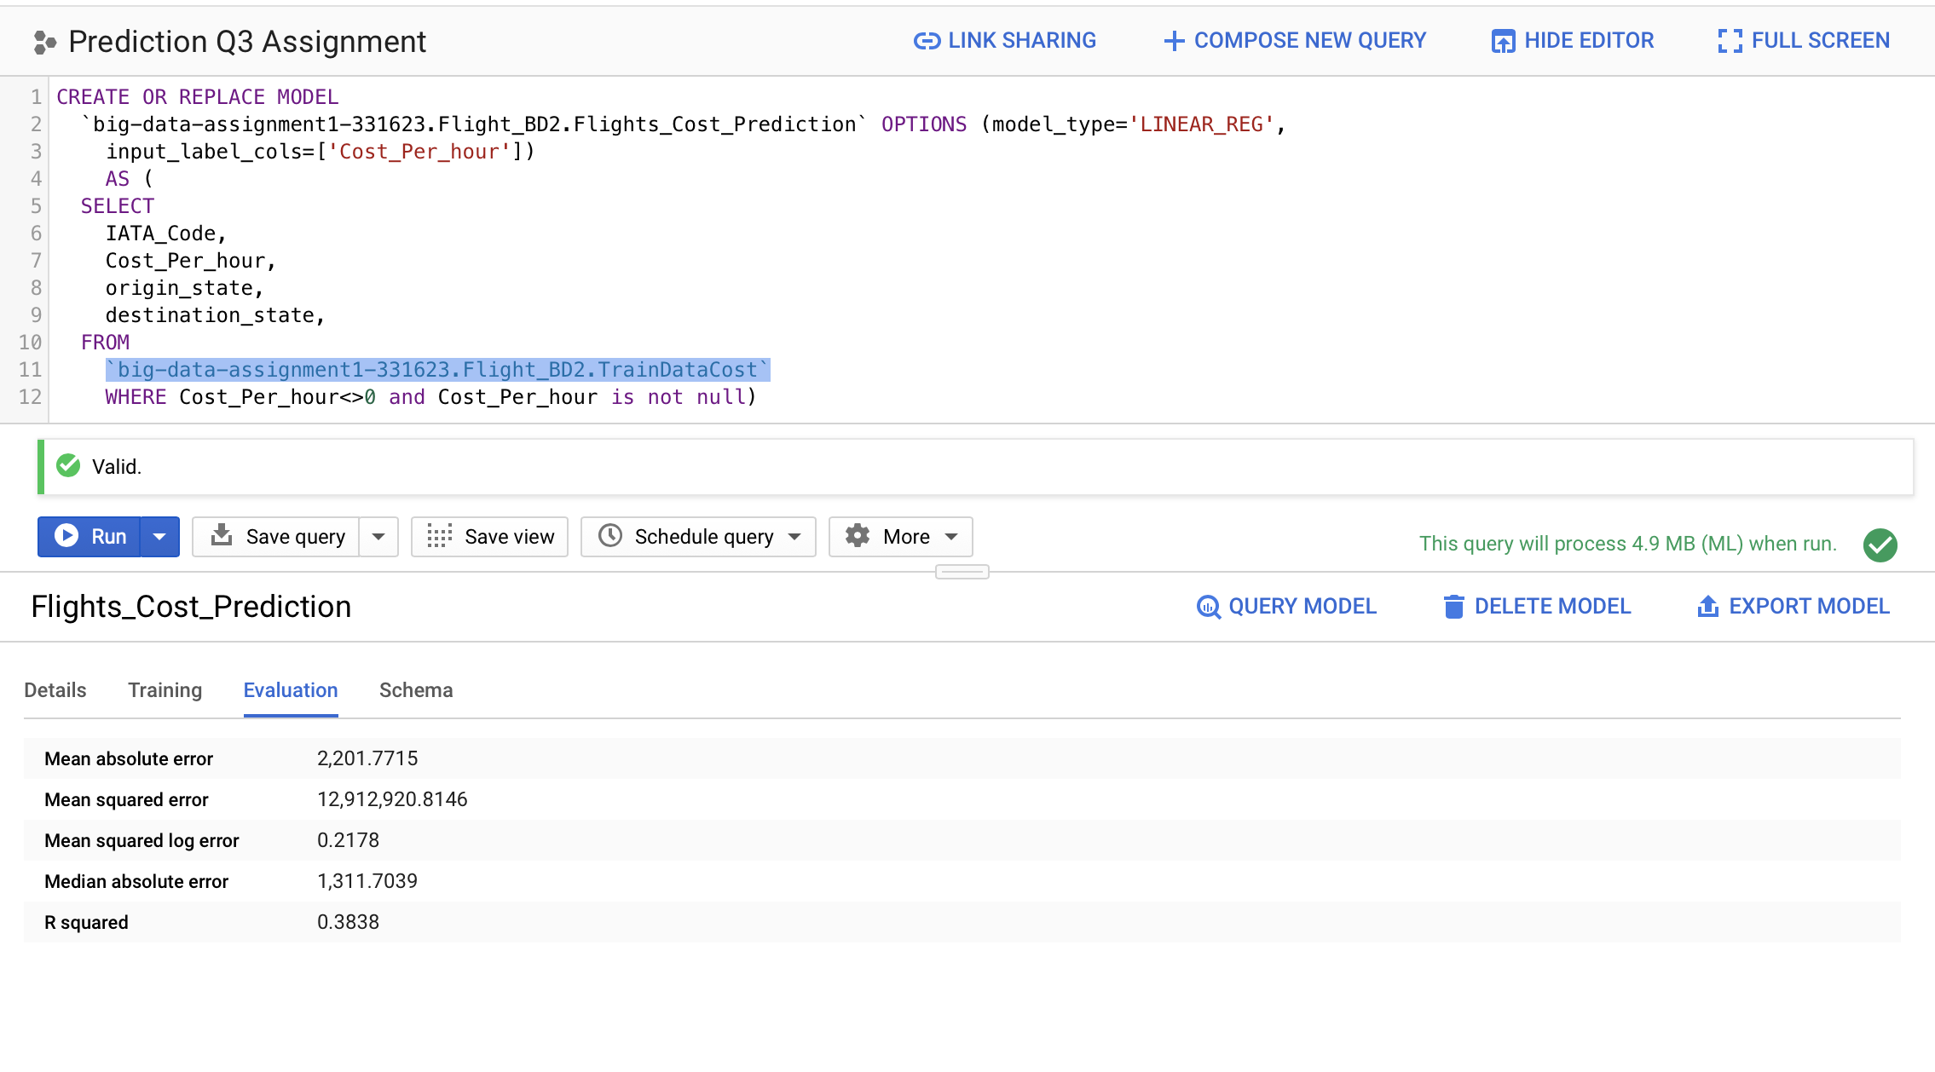
Develop models to predict the estimated cost and profit for any given flight for an origin destination pair and airlines
CREATE OR REPLACE MODEL
`big-data-assignment1-331623.Flight_BD2.Flights_Cost_Prediction` OPTIONS (model_type='LINEAR_REG',
input_label_cols=['Cost_Per_hour'])
AS (
SELECT
IATA_Code,
Cost_Per_hour,
origin_state,
destination_state,
FROM
`big-data-assignment1-331623.Flight_BD2.TrainDataCost`
WHERE Cost_Per_hour<>0 and Cost_Per_hour is not null)
Created a Linear Regression Model to predict the cost per hour for all the flights in the Streaming Data

Slide 35
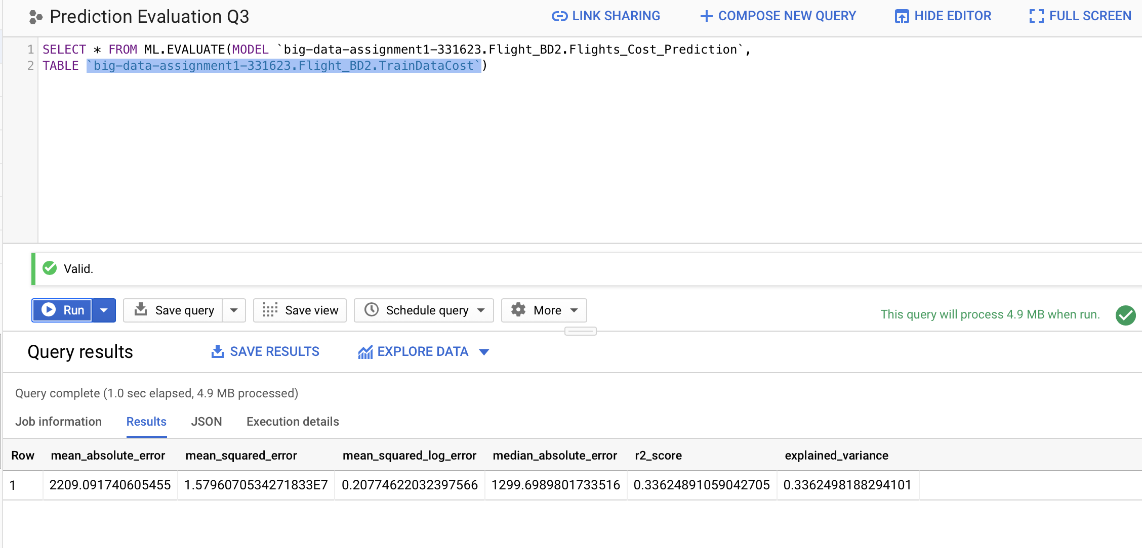
Develop models to predict the estimated cost and profit for any given flight for an origin destination pair and airlines
SELECT * FROM ML.EVALUATE(MODEL `big-data-assignment1-331623.Flight_BD2.Flights_Cost_Prediction`,
TABLE `big-data-assignment1-331623.Flight_BD2.TrainDataCost`)
Model Evaluation on Training Data

Slide 36
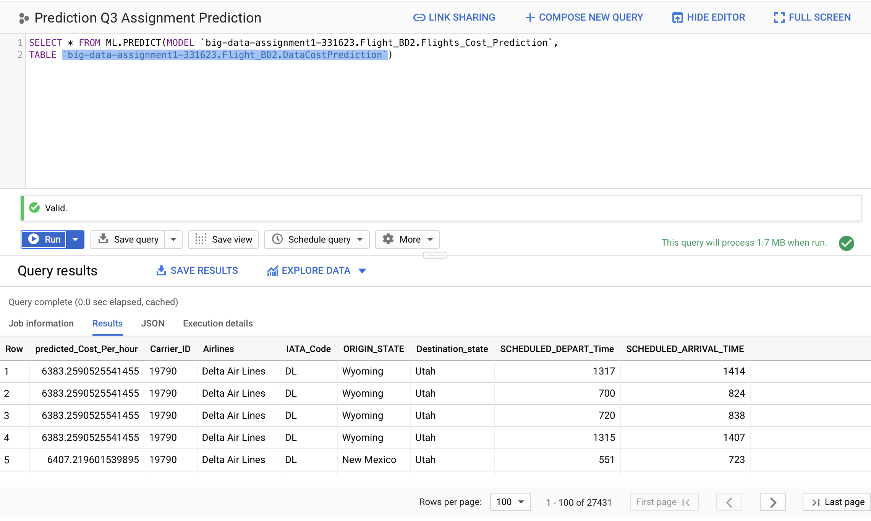
Develop models to predict the estimated cost and profit for any given flight for an origin destination pair and airlines
SELECT * FROM ML.PREDICT(MODEL `big-data-assignment1-331623.Flight_BD2.Flights_Cost_Prediction`,
TABLE `big-data-assignment1-331623.Flight_BD2.DataCostPrediction`)
Running Model to Predict Cost per Flying Hour for all the flights in the Streaming Data

Slide 37
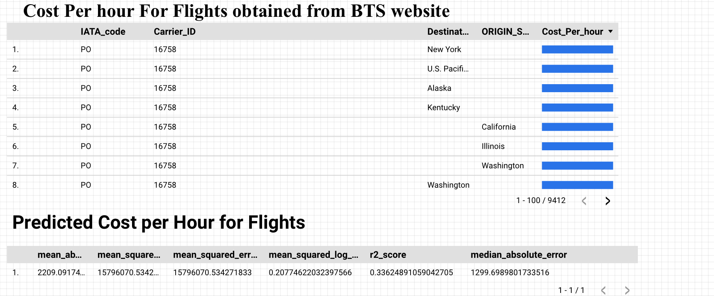
Develop models to predict the estimated cost and profit for any given flight for an origin destination pair and airlines
We downloaded the total operating cost and airtime from the Bureau of Traffic Statistics, and trained the model to predict all flight flow data
In the BTS data, some field in the Origin and Destination is missing only if the Origin and Destination doesn’t belong to the United States.
Training the model, we can see that the R-Square value is 0.34

Slide 38
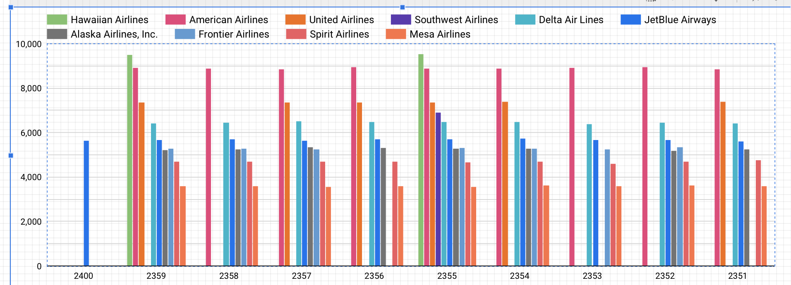
Develop models to predict the estimated cost and profit for any given flight for an origin destination pair and airlines
From the forecast data below, we can see that there are many flights that will arrive at their destinations at 23:55 pm, and the cost per flight hour associated with them. We can see that Hawaiian Airlines has the highest related costs, followed by American Airlines. In order to reduce costs while generating profits, we need to give priority to Hawaiian Airlines over other airlines. According to the cost, we should choose the flight to land, because any delay will cause additional costs.

Slide 39
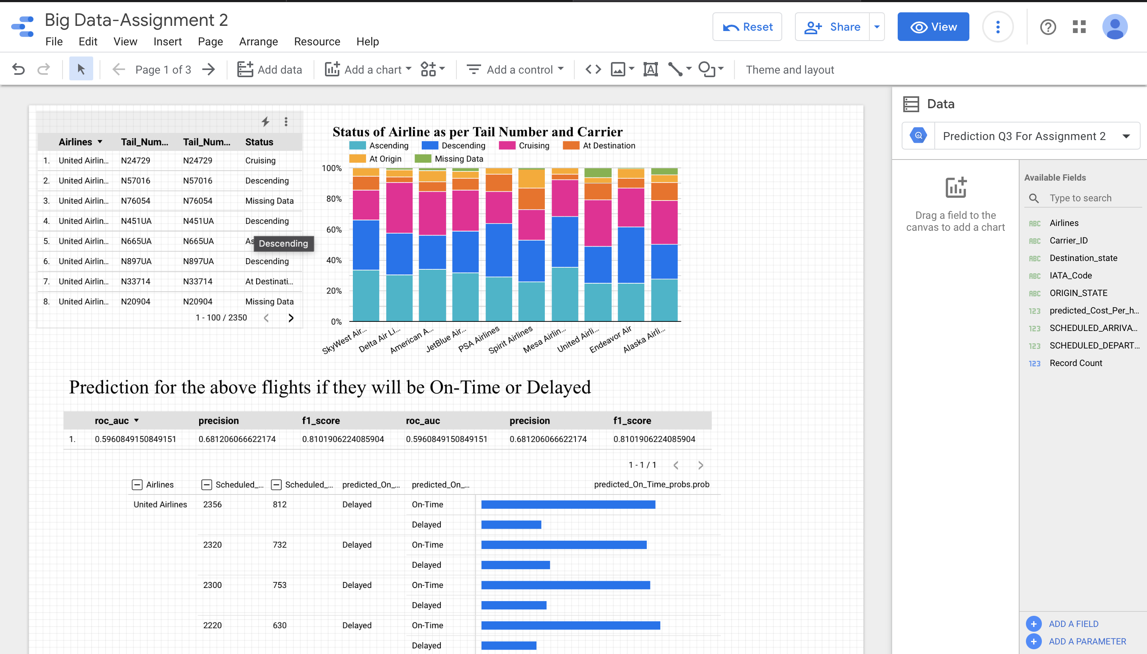
Dashboard

Slide 40

Team Contribution
Snigdha Rudola- SQL Queries , Visualization and PPT for “List the planes and Airlines that are on ground at the origin, ascending, in-route (cruising at a fixed altitude), descending, and on ground at the destination”
Jonathan Reji Mathai - SQL Queries , Visualization and PPT for “List the planes and Airlines that are on ground at the origin, ascending, in-route (cruising at a fixed altitude), descending, and on ground at the destination”
Shubham Agarwal- SQL Queries, Visualization and PPT for for “For the same origin-destination pair, airlines, day, and the time window, predict which flights will be delayed” and “Develop models to predict the estimated cost and profit for any given flight for an origin destination pair and airlines”.
Nityanand Kowtha - SQL Queries , Visualization and PPT for “List the planes and Airlines that are on ground at the origin, ascending, in-route (cruising at a fixed altitude), descending, and on ground at the destination”
Rajib Mahato- Data cleaning, Downloading Additional Table, SQL Queries, Visualization and PPT for “For the same origin-destination pair, airlines, day, and the time window, predict which flights will be delayed” and “Develop models to predict the estimated cost and profit for any given flight for an origin destination pair and airlines”. Creation of Dashboard
Dashboard Link- https://datastudio.google.com/reporting/daf6150c-f87f-4d46-88c2-2c04d968f2a9/page/FTIhC/edit

